Slide 1
Rocks Virtual Clusters, Extended clusters in to Amazon EC2 w/Condor
Philip Papadopoulos, Ph.D
University of California, San Diego
San Diego Supercomputer Center
California Institute for Telecommunications and Information Technology (Calit2)
CCGSC 2010, Flat Rock , North Carolina

Slide 2
Outline
Short Background on Rocks
Virtual Clusters
Practically extending a local cluster using “Hardware” in EC2 and Condor
EC2 Trials, Tribulations, Observations, Love and Hate
The Rocks Pilot for the remote control we should have (but don’t) in commercial clouds

Slide 3
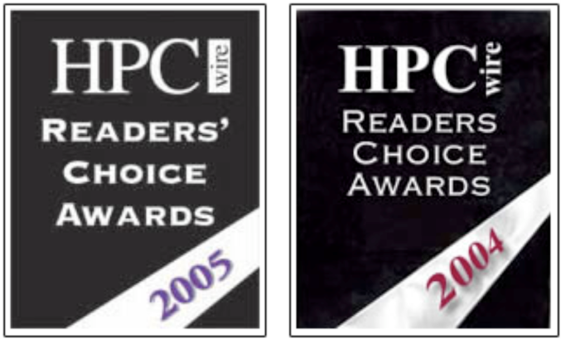

Rocks – http:// www.rocksclusters.org
Technology transfer of commodity clustering to application scientists
Rocks is a cluster/System Configuration on a CD
Clustering software (PBS, SGE, Ganglia, Condor, … )
Highly programmatic software configuration management
Put CDs in Raw Hardware, Drink Coffee, Have Cluster.
Extensible using “Rolls”
Large user community
Over 1PFlop of known clusters
Active user / support list of 2000+ users
Active Development
2 software releases per year
Code Development at SDSC
Other Developers (UCSD, Univ of Tromso, External Rolls
Supports Redhat Linux, Scientific Linux, Centos and Solaris
Can build Real, Virtual, and Hybrid Combinations (2 – 1000s)
Rocks Core Development NSF award #OCI-0721623

Slide 4


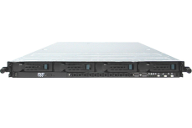
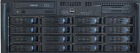
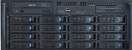
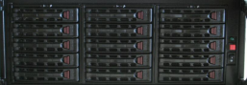

A Mid-Sized Cluster Resource
Includes : Computing, Database, Storage, Virtual Clusters, Login, Management Appliances
Triton Resource
Large Memory PSDAF
256 GB & 512 GB Nodes (32 core)
8TB Total
128 GB/sec
~ 9TF
Shared Resource
Cluster
16 GB/Node
4 - 8TB Total
256 GB/sec
~ 20 TF
x256
x28
UCSD Research Labs
Large Scale Storage
(Working on RFP)
2 PB ( 384 TB Today)
~50 GB/sec ( 7 GB/s )
~ 3000 (384 Disks Now)
Campus Research Network
http://tritonresource.sdsc.edu

Slide 5
Key Rocks Concepts
Define components of clusters as Logical Appliances (Compute, Web, Mgmt, Login DB, PFS Metadata, PFS Data, … )
Share common configuration among appliances
Graph decomposition of the full cluster SW and Config
Use installer’s (Redhat Anaconda, Solaris Jumpstart) text format to describe an appliance configuration
Walk the Rocks graph to compile this definition
Heterogeneous Hardware (Real and Virtual HW) with no additional effort

Slide 6
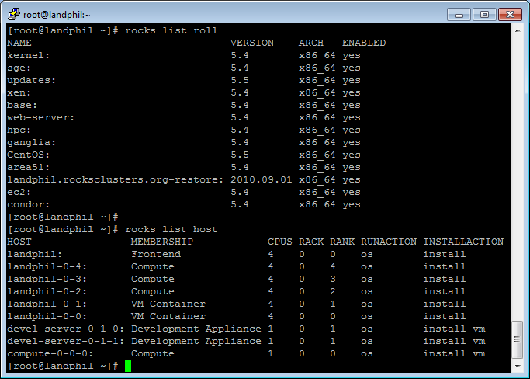
Rolls: Decompose the Software Stack Selected Rolls Define Your System

Slide 7
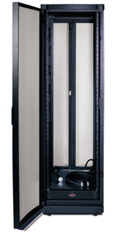
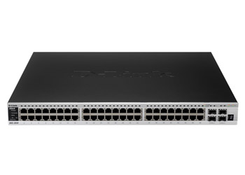
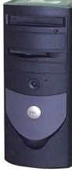
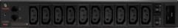
Virtual Clusters in Rocks Today
Virtual Cluster 1
Require:
Virtual Frontend
Nodes w/disk
Private Network
Power
Virtual Cluster 2
Virtual Clusters:
May overlap one another on physical HW
Need network isolation
May be larger or smaller than physical hosting cluster
Physical Hosting Cluster
“Cloud Provider”

Slide 8
How Rocks Treats Virtual Hardware
It’s just another piece of HW.
If RedHat supports it, so does Rocks
Allows mixture of real and virtual hardware in the same cluster
Because Rocks supports heterogeneous HW clusters
Re-use of all of the software configuration mechanics
E.g., a compute appliance is compute appliance, regardless of “Hardware”
Virtual HW must meet minimum HW Specs
1GB memory
36GB Disk space*
Private-network Ethernet
+ Public Network on Frontend
* Not strict – EC2 images are 10GB

Slide 9
Inside VM Hosting (Physical) Cluster must Provide Network Plumbing
Linux (and Solaris) supports explicit tagging
eth0 = Physical Network
eth0.144
Tag outgoing packets with VLAN ID 144
Receive only packets tagged with ID 144
Bridges (Software Ethernet Switches) utilized by Xen
Xen Dom0
VM1
VM-N
Physical Host
VM2
xenbr.eth0 (bridge)
xenbr.eth0.144
(bridge)
eth0 (untagged)
eth0.144 (VLAN 144)
Tag /
Un-tag
144
Here
physical interface
Switch must be configured to support native (untagged) VLAN and tagged VLAN (e.g. 144)

Slide 10
Assembly into Virtual Clusters: Overlay on Physical
Virtual Cluster
Rocks simplifies creation of all network interfaces
Real, virtual & bridges
VM’s are blind to the actual packet tag being used

Slide 11
Some Realities of Virtual Clusters
When you start building Hosting Clusters, you build many clusters
Viewpoints:
Physical Cluster that Hosts Virtual Machines
Cloud Provider: Allocation of resources (disk, network, CPU, memory) to define a virtual cluster
Cluster Owner: Configuration of Software to define your environment
Your first virtual cluster requires you to define three clusters and build two
Rocks > 5.0 provides infrastructure for all of this
Share as much as possible

Slide 12
A Taste of the Command Line
Build Physical Hosting Cluster with Xen Roll and build vm-container appliances
Allocate resources for a virtual cluster
rocks create cluster <ip of virtual frontend> <fqdn of frontend> <# of nodes> vlan=<vlanid> [<options>]
Start and build virtual cluster frontend
rocks start host vm <fqdn of frontend>
rocks open host vm console <fqdn of frontend>

Slide 13
Rocks and EC2
We can build physical hosting clusters and multiple, isolated virtual clusters:
Can I use Rocks to author “images” compatible with EC2? (We use Xen, They use Xen)
Can I automatically integrate EC2 Virtual Machines into my local cluster (cluster extension)
Submit locally
My own private cloud

Slide 14


Basic EC2
Elastic Compute Cloud (EC2)
Amazon Cloud Storage
Copy AMI &
Boot
S3 – Simple Storage Service
EBS – Elastic Block Store
AMIs are copied from S3 and booted in EC2 to create a “running instance”
When instance is shutdown, all changes are lost
Can save as a new AMI
Amazon Machine Images (AMIs)

Slide 15
Basic EC2
AMI (Amazon Machine Image) is copied from S3 to EC2 for booting
Can boot multiple copies of an AMI as a “group”
Not a cluster, all running instances are independent
New “Cluster” Instances are about $2/Hr (8 cores) ($17K/year)
If you make changes to your AMI while running and want them saved
Must repack to make a new AMI
Or use Elastic Block Store (EBS) on a per-instance basis

Slide 16
Some Challenges in EC2
Defining the contents of your Virtual Machine (Software Stack)
Understanding limitations and execution model
Debugging when something goes wrong
Remembering to turn off your VM
Smallest 64-bit VM is ~$250/month running 7x24

Slide 17
Why do we even care about about how a (IAAS) Cloud image is made?

Slide 18
A: Too MANY pre-existing AMIs. No Systematic (scientific) Reproducibility

Slide 19
What’s in the AMI?
Tar file of a / file system
Cryptographically signed so that Amazon can open it, but other users cannot
Split into 10MB chunks, stored in S3
Amazon boasts more than 5400 public machine images
What’s in a particular image?
How much work is it to get your software part of an existing image?
There are tools for booting and monitoring instances.
Defining the software contents is “an exercise left to the reader”

Slide 20
Condor Roll
Condor 7.42
Integration with Rocks command line to do basic Condor configuration customization
To build a Condor Cluster with Rocks
Base, OS, Kernel, Condor Roll
Gives you local collector, scheduler
Basic, Working Configuration that can be customized as required.

Slide 21
The EC2 Roll
Take a Rocks appliance and make it compatible with EC2:
10GB disk partition (single)
DHCP for network
ssh key management
Other small adjustments
Create an AMI bundle on local cluster
rocks create ec2 bundle
Upload a bundled image into EC2
rocks upload ec2 bundle
Mini-tutorial on getting started with EC2 and Rocks
Register image and go.

Slide 22





Putting it All Together + Rocks + Condor + EC2
User sees one Condor Pool. Local interaction
Amazon EC2 Cloud
Nimrod.rockscluster.org
Rocks –Created VM
fiji.rocksclusters.org Hosting Cluster
for Job Management

Slide 23
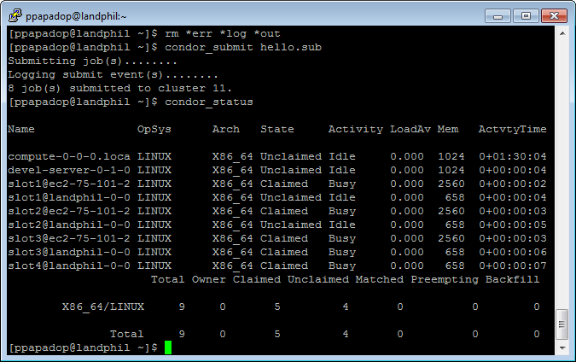
Extended Cluster Using Condor

Slide 24
Steps to Make this Work
Build Local Cluster with appropriate rolls
Rocks + Xen Roll + EC2 Roll + Condor Roll (+ ++ Your Rolls Here>)
Create local appliance as VM using standard Rocks tools
Set ec2_enable attribute to build it as an EC2-Compatible VM
Build and test locally ( can run EC2 kernel on local machine)
Bundle, Upload, Register as an EC2 AMI
Rocks command line tools
PREPARATION
RUN
Boot with appropriate meta data to register automatically with your local collector.
ec2-run-instances -t m1.large ami-219d7248 -d "condor:landphil.rocksclusters.org:40000:40050"
Requires one-time EC2 firewall settings
Use your extended Condor Pool

Slide 25
Some “Fun” things with EC2
New API for old concepts
Power on/off (ec2-run-instances, ec2-terminate-instances, ec2-stop-instances), Save a system “image” (ec2-bundle-image, ec2-create-snapshot), etc.
90 + “New” Commands. Considered a de-facto standard API (See Eucalyptus)
Slow cycle time for various operations – EC2 Instance 0.01 - $2.88/hour vs. People @ about $100/Hr.
No console access. SSH only. Your VM not reachable via SSH? you are out of luck.
Very little to no intermediate debug output
Instance transitions from “pending” to “terminated” with no discernable reason code. Try running again and it just might work.
Bundling of an AMI not very reliable on a running system
… Pick your issue here.
All are solvable. Great idea. Implementation still needs work.

Slide 26

The ONE thing I wish I had in EC2
Console!
(Okay, Really two things: MUCH faster cycle time from software change to packed AMI)

Slide 27
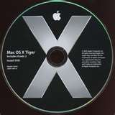
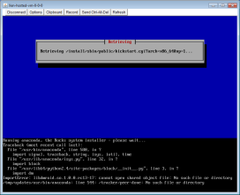


User-Level Cloud Combat Maneuvers The Rocks Pilot (in 5.4)
Frontend
OS Native Requires Root. Airboss gives limited access to users (Public Key Crypto)
AirBoss
Vi-1.rocksclusters.org
SSH tunnel
My Virtual Cluster
Power and Console to ANY of my VMs in my Virtual Cluster
Pilot
Physical Hosting Cluster
“Build-x86-64.rocksclusters.org”

Slide 28
Movie Clip!

Slide 29
Summary
Easily Extend your Condor pool into EC2
Others can do this as well
Condor supports the public/private network duality of EC2
Have your software on both local cluster and remote VM in EC2
Mix and match
Local Physical, Local Virtual, Remote Virtual
Familiar tools and paradigms for cloud-hosted VMs.

