Slide 1
Multicore and Cloud Futures
CCGSC
September 15 2008
Geoffrey Fox
Community Grids Laboratory, School of informatics
Indiana University
gcf@indiana.edu, http://www.infomall.org
1
Notes:
1

Slide 2
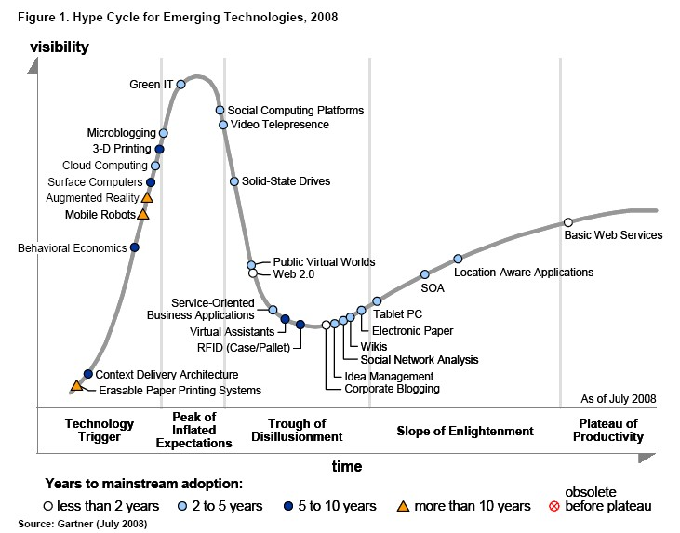
Gartner 2008 Technology Hype Curve
Clouds, Microblogs and Green IT appear
Basic Web Services, Wikis and SOA
becoming mainstream
MPI way out on plateau?
Grids?

Slide 3
Gartner 2006 Technology Hype Curve
Grids did exist

Slide 4
Grids become Clouds
Grids solve problem of too little computing: We need to harness all the world’s computers to do Science
Clouds solve the problem of too much computing: with multicore we have so much power that we need to make usage much easier
Key technology: Virtual Machines (dynamic deployment) enable more dynamic flexible environments
  Is Virtual Cluster or Virtual Machine correct primitive?
Data Grids seem fine as data naturally distributed
GGF/EGA false assumption: Web 2.0 not Enterprise defined commercial software stack
  Some Web 2.0 applications (MapReduce) not so different from data-deluged eScience
Citizen Science requires light weight friendly Cyberinfrastructure

Slide 5
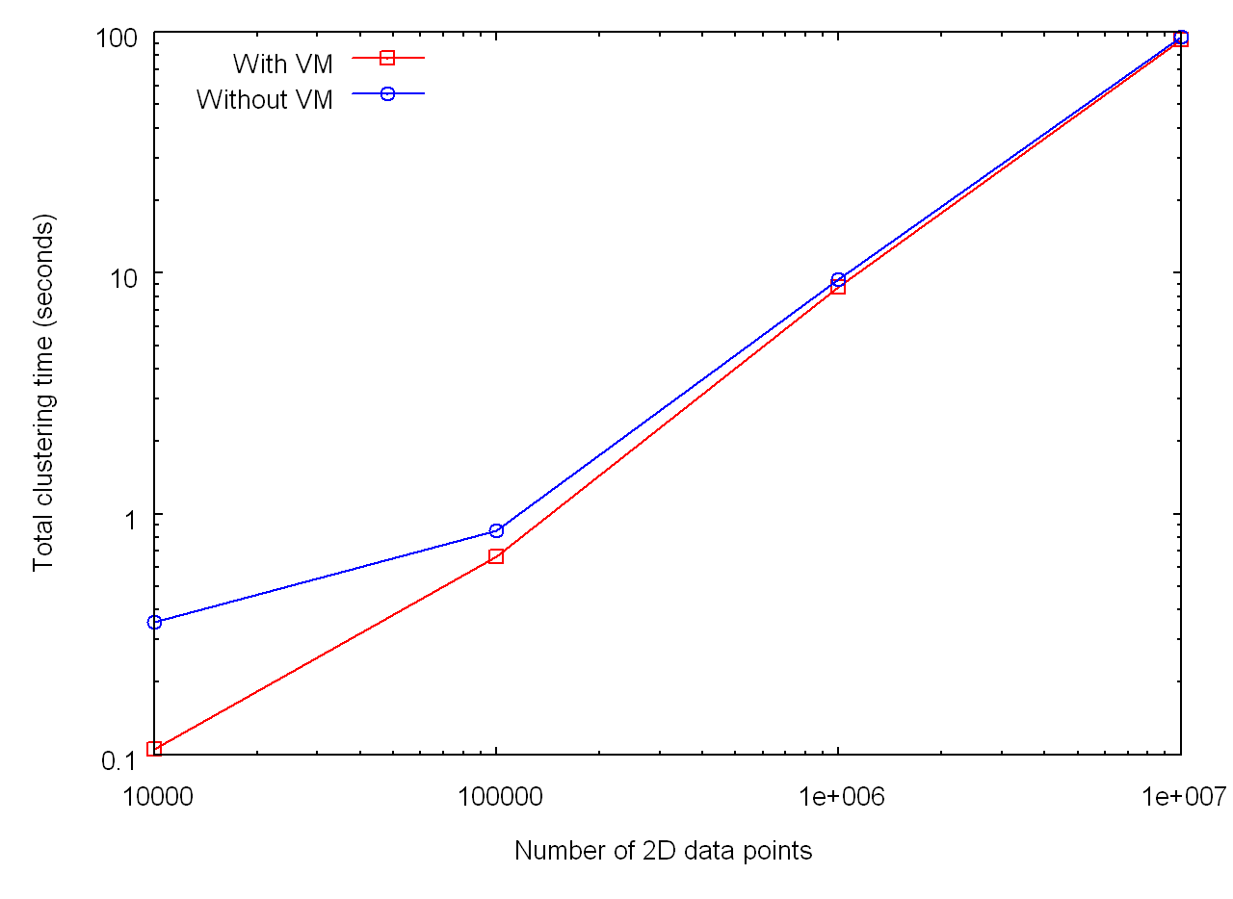
MPI on Nimbus for clustering
Note fluctuations in runtime but performance OK for large enough problems
8 Nodes

Slide 6
Plans for QuakeSpace
QuakeSim supports Earthquake Scientists who want some features of their kid’s (under 40) world
Rebuild QuakeSim using Web 2.0 and Cloud Technology
Applications, Sensors, Data Repositories as Services
Computing via Clouds
Portals as Gadgets
Metadata by tagging
Data sharing as in YouTube
Alerts by RSS
Virtual Organizations via Social Networking
Workflow by Mashups
Performance by multicore
Interfaces via iPhone, Android etc.

Slide 7
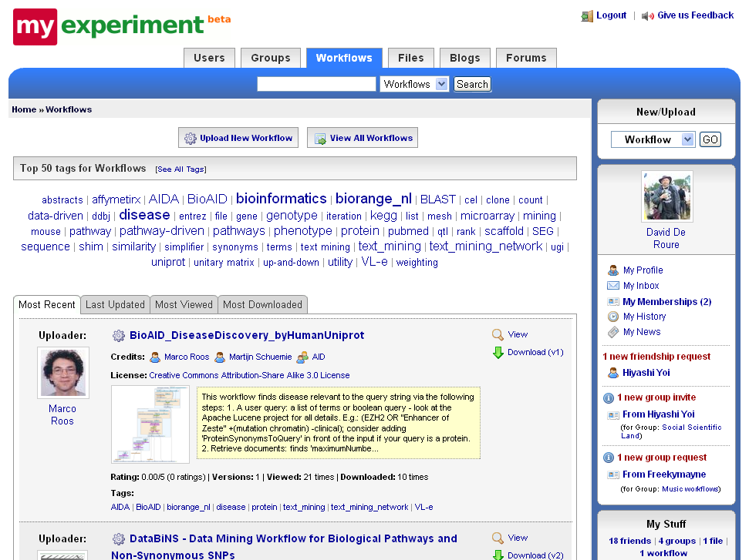

Slide 8
Enterprise Approach | Web 2.0 Approach
JSR 168 Portlets | Gadgets, Widgets
Server-side integration and processing | AJAX, client-side integration and processing, JavaScript
SOAP | RSS, Atom, JSON
WSDL | REST (GET, PUT, DELETE, POST)
Portlet Containers | Open Social Containers (Orkut, LinkedIn, Shindig); Facebook; StartPages
User Centric Gateways | Social Networking Portals
Workflow managers (Taverna, Kepler, etc) | Mash-ups
Grid computing: Globus, Condor, etc | Cloud computing: Amazon WS Suite, Xen Virtualization, still Condor!

Slide 9
Different Programming Models
(Web) services, "farm" computations, Workflow (including AVS, HeNCE from past), Mashups, MPI, MapReduce run functionally or data decomposed execution units with a wide variety of front ends
Front-end: Language+communication library, Scripting, Visual, Functional, XML, PGAS, HPCS Parallel Languages, Templates, OpenMP
Synchronize/Communicate with some variant of messaging (zero size for locks) with performance, flexibility, fault-tolerance, dynamism trade-offs
Synchronization: Locks Threads Processes CCR CCI SOAP REST MPI Hadoop; not much difference for user?

Slide 10
MPI becomes Ghetto MPI
Multicore best practice not messaging will drive synchronization/communication primitives
Party Line Programming Model: Workflow (parallel--distributed) controlling optimized library calls
  Core parallel implementations no easier than before; deployment is easier
MPI is wonderful; it will be ignored in real world unless simplified
CCI notes MPI is HPCC Ghetto
CCI is high performance distributed message passing ghetto?
CCR from Microsoft – only ~7 primitives – is one possible commodity multicore driver
  It is roughly active messages
  Will run MPI style codes fine on multicore

Slide 11
Deterministic Annealing Clustering
Scaled Speedup Tests on 4 8-core Systems
1,600,000 points per C# thread
1, 2, 4. 8, 16, 32-way parallelism
Parallel
Overhead =
(PT(P)/T(1)-1)
On P processors
= (1/efficiency)-1
32-way
16-way
2-way
8-way
4-way
Nodes
1 2 1 1 4 2 1 2 1 1 4 2 1 4 2 1 2 1 1 4 2 4 2 4 2 2 4 4 4 4
MPI Processes per Node
1 1 2 1 1 2 4 1 2 1 2 4 8 1 2 4 1 2 1 4 8 2 4 1 2 1 8 4 2 1
CCR Threads per Process
1 1 1 2 1 1 1 2 2 4 1 1 1 2 2 2 4 4 8 1 1 2 2 4 4 8 1 2 4 8

Slide 12
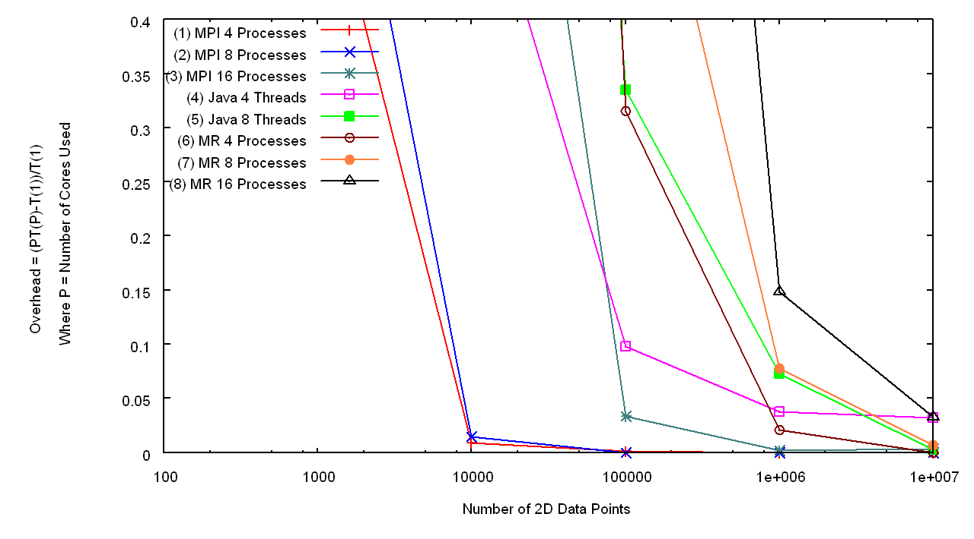
MPI, MapReduce, Java Threads for Clustering
Overhead PT(P)/T(1)-1 of the messaging runtime for the different data sizes
All perform well for large enough datasets
MR
Java
Java
MPI
MR
MR
MPI
MPI
Number of Data Points

Slide 13
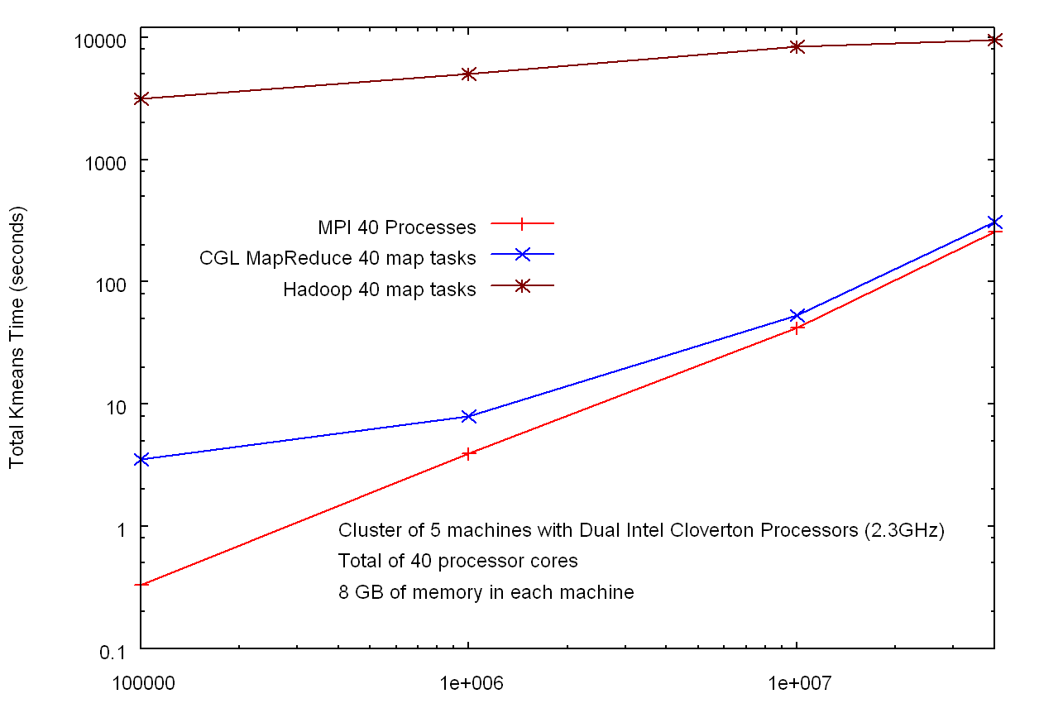
Hadoop v MPI and faster MapReduce for Clustering
HADOOP
Factor of 30
Factor of 10³
In memory MapReduce
MPI
Number of Data Points

Slide 14
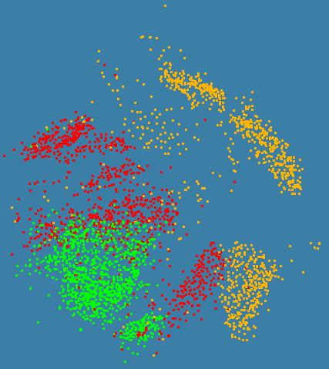
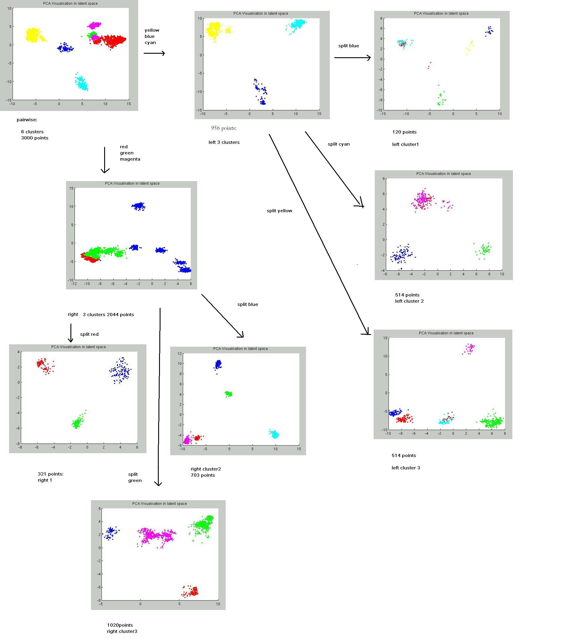
N=3000 sequences each length ~1000 features
Only use pairwise distances will repeat with 0.1 to `0.5 million sequences with a larger machine
C# with CCR and MPI

