Slide 1
eScience, Semantic Computing and the Cloud
Towards a Smart Cyberinfrastructure
Tony Hey
Corporate Vice President
Microsoft Research

Slide 2
eScience

Slide 3
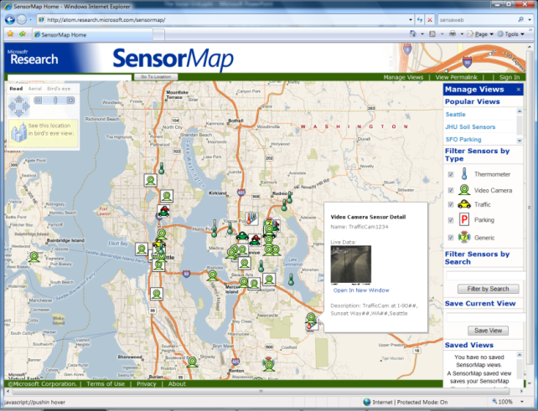
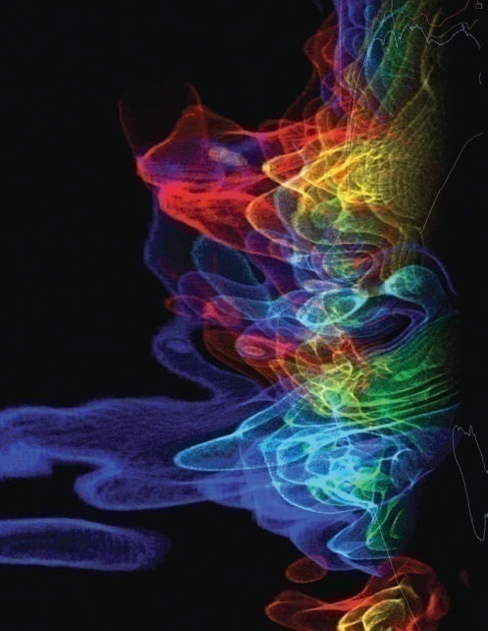
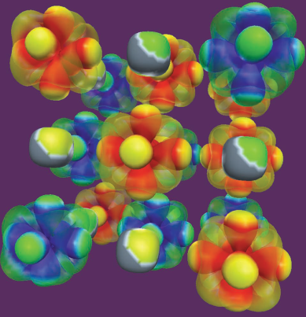
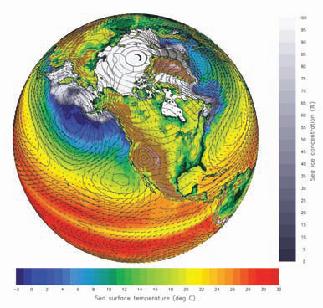
A Data Deluge in Science
Data collection
  Sensor networks, satellite surveys, high throughput laboratory instruments, observation devices, supercomputers, LHC …
Data processing, analysis, visualization
  Legacy codes, workflows, data mining, indexing, searching, graphics …
Archiving
  Digital repositories, libraries, preservation, …
SensorMap
  Functionality: Map navigation
  Data: sensor-generated temperature, video camera feed, traffic feeds, etc.
Scientific visualizations
  NSF Cyberinfrastructure report, March 2007

Slide 4
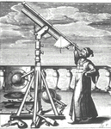
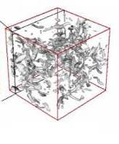
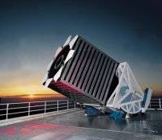

Emergence of a New Research Paradigm?
Thousand years ago – Experimental Science
  Description of natural phenomena
Last few hundred years – Theoretical Science
  Newton’s Laws, Maxwell’s Equations…
Last few decades – Computational Science
  Simulation of complex phenomena
Today – eScience or Data-centric Science
  Unify theory, experiment, and simulation
  Using data exploration and data mining
    Data captured by instruments
    Data generated by simulations
    Data generated by sensor networks
  Scientists overwhelmed with data
  Computer Science and IT companies
  have technologies that will help
(With thanks to Jim Gray)

Slide 5
Today
Web users...
Generate content on the Web
  Blogs, wikis, podcasts, videocasts, etc.
Form communities
  Social networks, virtual worlds
Interact, collaborate, share
  Instant messaging, web forums, content sites
Consume information and services
  Search, annotate, syndicate
Scientists...
Annotate, share, discover data
  Custom, standalone tools
Conferences, Journals
  Publication process is long, subscriptions, discoverability issues
Collaborate on projects, exchange ideas
  Email, F2F meetings, video-conferences
Use workflow tools to compose services
  Domain-specific services/tools

Slide 6


Open Collaboration
Open access
Open source
Open data
“In order to help catalyze and facilitate
the growth of advanced CI, a critical
component is the adoption of open access
policy for data, publications and software.”
NSF Advisory Committee on
Cyberinfrastructure (ACCI)
Microsoft Interoperability Principles
  Open Connections to Microsoft Products
  Support for Standards
  Data Portability
  Open Engagement
http://www.microsoft.com/interop/

Slide 7
Today…
storing
computing
managing
indexing
Computers are
great tools for
huge amounts
of data
For example, Google and Microsoft both have copies of the Web for indexing purposes

Slide 8
Tomorrow…
storing
computing
managing
indexing
Computers will still
be great tools for
huge amounts
of data
acquisition
aggregation
organization
correlation
interpretation
inference
discovery
analysis
We would like
computers to also
help with the
automatic
of the world’s
information

Slide 9
Semantic Computing

Slide 10
Need for Semantic Computing?
Semantic computing combines concepts and technologies that
  Enable data modeling
  Capture relationships
  Allow communities to define ontologies
  Exploit machine learning
Will empower computers to reason about the data
Data
Information
Knowledge
Current technologies
Possibilities for innovation

Slide 11
Semantic Computing
Some efforts are driven by the traditional “knowledge engineering” community
  Engaged in building well-controlled ontologies
  Important for domain-specific vocabularies with data formats and relationships specific to a community
  Model does not easily scale to the Internet
Some efforts are driven by the Web 2.0 community
  Focus on the pervasiveness of Web protocols/standards
  Emphasis on microformats (small, flexible, embeddable structures)
  Exploit evolving and ever-expanding vocabularies such as folksonomies and tag clouds

Slide 12
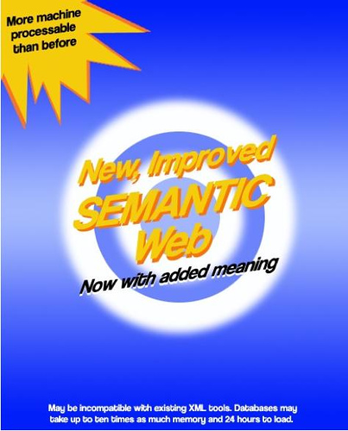
Semantic Web as the platform?
Mark Butler (2003) Is the semantic web hype?
http:/www.hpl.hp.com/personal/marbut/isTheSemanticWebHype.pdf
Notes:
Mark Butler (2003) Is the semantic web hype? Hewlett Packard laboratories presentation at MMU, 2003-03-12

Slide 13

Cloud Computing

Slide 14
Rationale for Cloud computing
Outsourcing of IT infrastructure
Minimize costs
  Large cloud/utility computing provides can have relatively very small ownership and operational costs due to the huge scale of deployment and automation
Small businesses have access to large scale resources
  The acquisition, operation, and maintenance costs would have been prohibiting

Slide 15
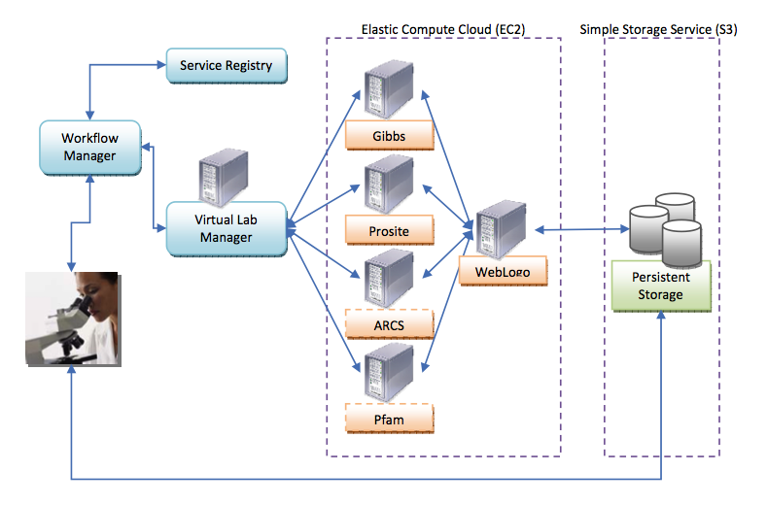
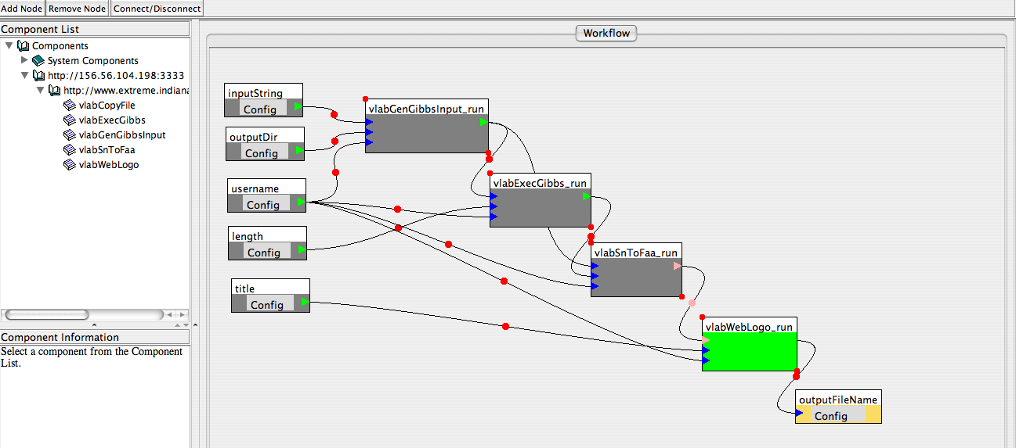
Example: Amazon Web Services
Simple Storage Service (S3)
storage for the Internet
Simple Web Services interface to store and retrieve any amount of data from anywhere on the Web
SimpleDB
Structured data
Simple Queue Service
Scalable message queuing
Elastic Compute Cloud (EC2)
Compute on demand
Virtualization
Integration with S3
Gene Analysis Virtual
Lab Experiment
by Jong Youl Choi at Indiana
(Beth Plale and Sun Kim)
Standards-based REST and SOAP Web Service interfaces

Slide 16
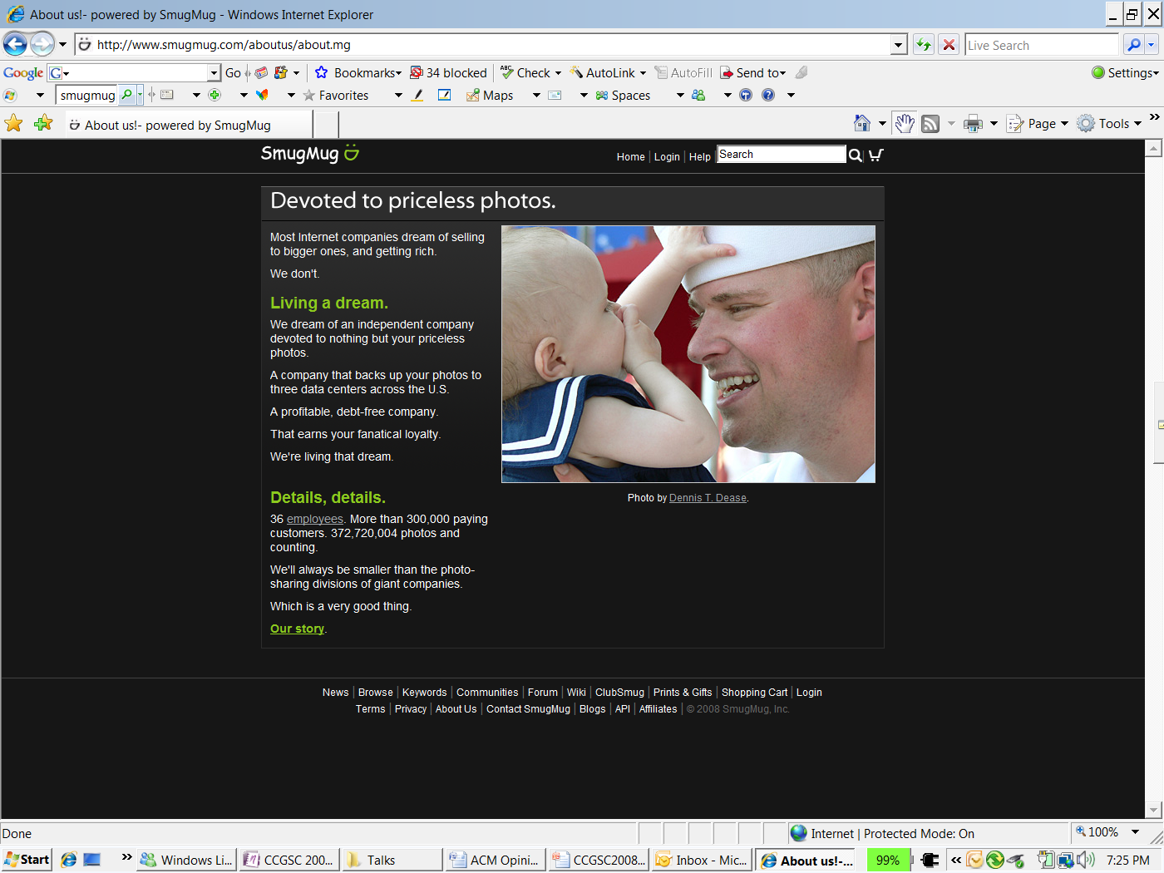
www.smugmug.com

Slide 17
Microsoft Cloud Services
Exchange
Live ID
Xbox Live
SQL Server Data Services
Office Live Workspaces
Windows Live
Live Mesh
.NET Online
Many more coming

Slide 18
eScience and
Cloud Computing
in action

Slide 19


The SkyServer Project
Jim Gray (MSR) and Alex Szalay (JHU)
The Sloan Digital Sky Survey (SDSS):
The “Cosmic Genome Project”
  5 color images of ¼ of the sky
  Pictures of 300 million celestial objects
  Distances to the closest 1 million galaxies
Built the public archive for the SDSS
Interesting challenge in digital publishing
  Have to publish first in order to analyze

Slide 20
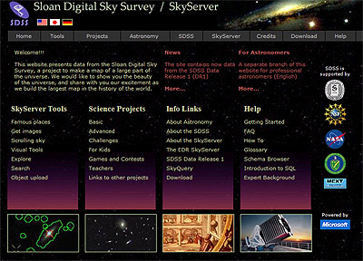
Public Use of the SkyServer
Posterchild in 21st century data publishing
  380 million web hits in 6 years
  930,000 distinct users
  vs 10,000 astronomers
  1600 refereed papers!
  Delivered 50,000 hours
  of lectures to high schools
  Delivered 100B rows of data
World’s most used astronomy facility for last 2 years

Slide 21
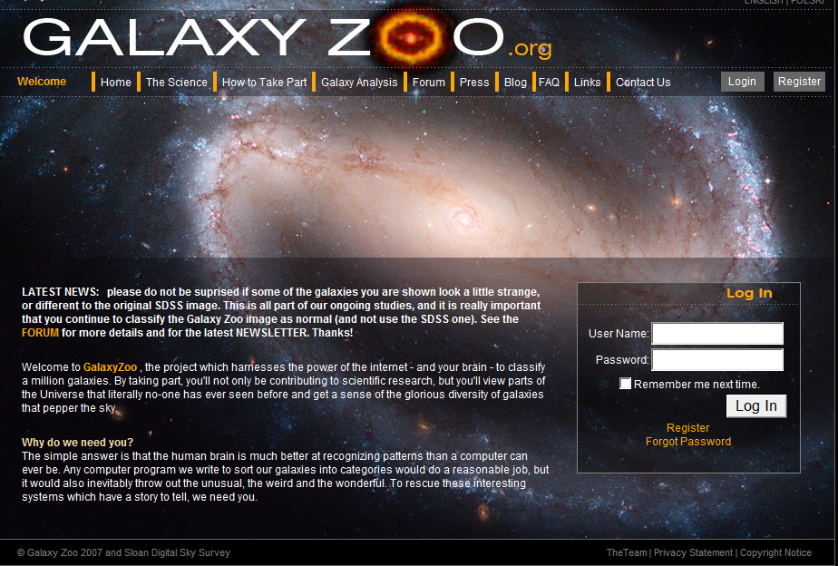
GalaxyZoo
Goal of 1 million visual galaxy classifications by the public
Enormous publicity (CNN, Times, Washington Post, BBC)
100,000 people participating, blogs, poems …
Application is like Amazon’s ‘Mechanical Turk’ Web Service that allows users to search for photographs …

Slide 22
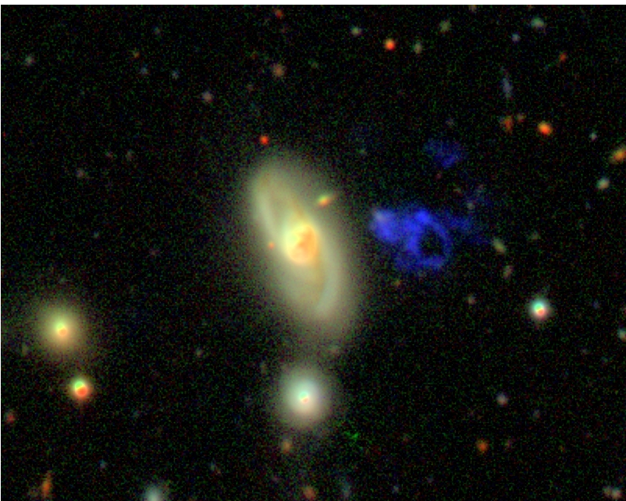
Hanny’s Voorwerp

Slide 23

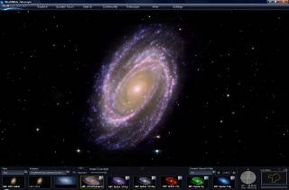
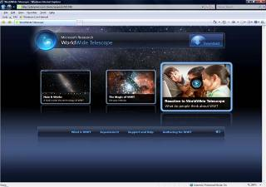
World Wide Telescope
Seamless Rich Social Media Virtual Sky
Web application for science and education
Participants
Alyssa Goodman; Harvard University
Alex Szalay; Johns Hopkins University
Curtis Wong, Jonathan Fay; Microsoft Research
Goals
Integration of data sets and one-click contextual access
Easy access and use
In just over a little more than two months, a million users have downloaded, installed and launched the application (2,206,497 unique sessions)
We invite you to experience it! www.worldwidetelescope.org

Slide 24

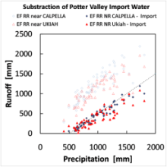







Berkeley Water Center
Understanding regional hydrology
Project Organization
Jim Hunt, Dennis Baldocchi, UC Berkeley
Deb Agarwal, Lawrence Berkeley Laboratory
Catharine van Ingen, MSR
eddy.lbl.gov
Database archive
Data ingest and cube development
bwc.berkeley.edu
Web site
external datacube access
Xena.lbl.gov
heavy database queries and cube development
Goals
Enable rapid scientific data browsing for availability and applicability
Enable environmental science via data synthesis from multiple sources
www.fluxdata.org
Sharepoint secured data file download
tas.lbl.gov
DC for flux domain
wally.lbl.gov
MatLab and ArcGIS for key scientists
hagar.lbl.gov
Backup gateway
Proof Points
Environmental Data Server, www.fluxdata.org (SharePoint), serves 921 site years of carbon-climate field data from 160+ field teams to 60+ paper writing teams (800M values)
Multiple projects now leveraging same SQL Server database and data cube approach
CUAHSI consortium: 100 universities collaborating on hydrology

Slide 25
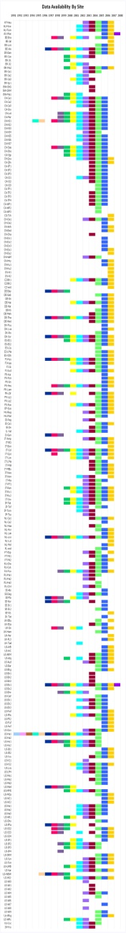
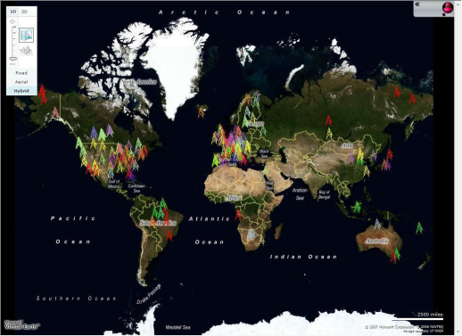

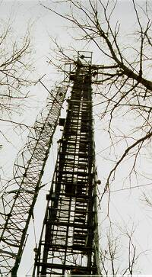
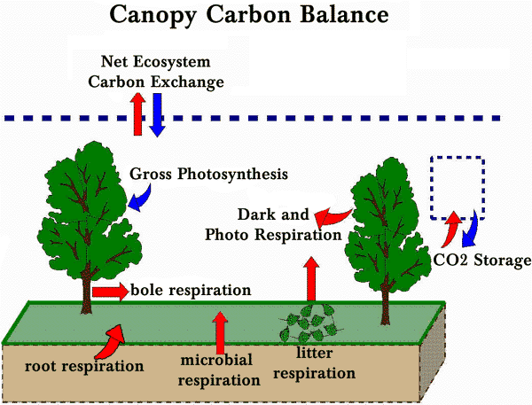
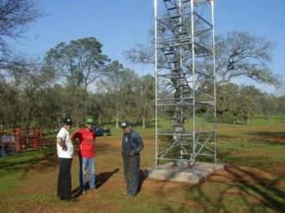
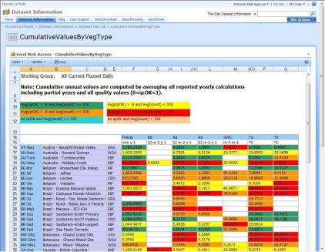
Carbo-Climate Synthesis (BWC Dennis Baldocchi et al)
What is the role of photosynthesis in global warming?
  Measurements of CO2 in the atmosphere show 16-20% less than emissions estimates predict
  The difference is either due to plants or ocean absorption.
Communal field science – each investigator acts independently.
Cross site studies and integration with modeling increasingly important
Sharepoint site www.fluxnet.org
  921 site-years of data from 240 sites around the world; 80+ site-years now being added
  60+ paper writing teams
  American data subset is public and served more widely
  Summary data products greatly simplify initial data discovery
Notes:
The plot is comparing previous values reported in the literature with values in the new dataset. These sorts of comparisons are helping the scientists trust the data as well as get their heads around what “accuracy” we’re talking about given the uniformity of processing (different from what the scientist would do independently).
The Excel sheet is one of our summary data products – find your site-year at a glance with color coding for gap-fill quality, % of data actually present….

Slide 26
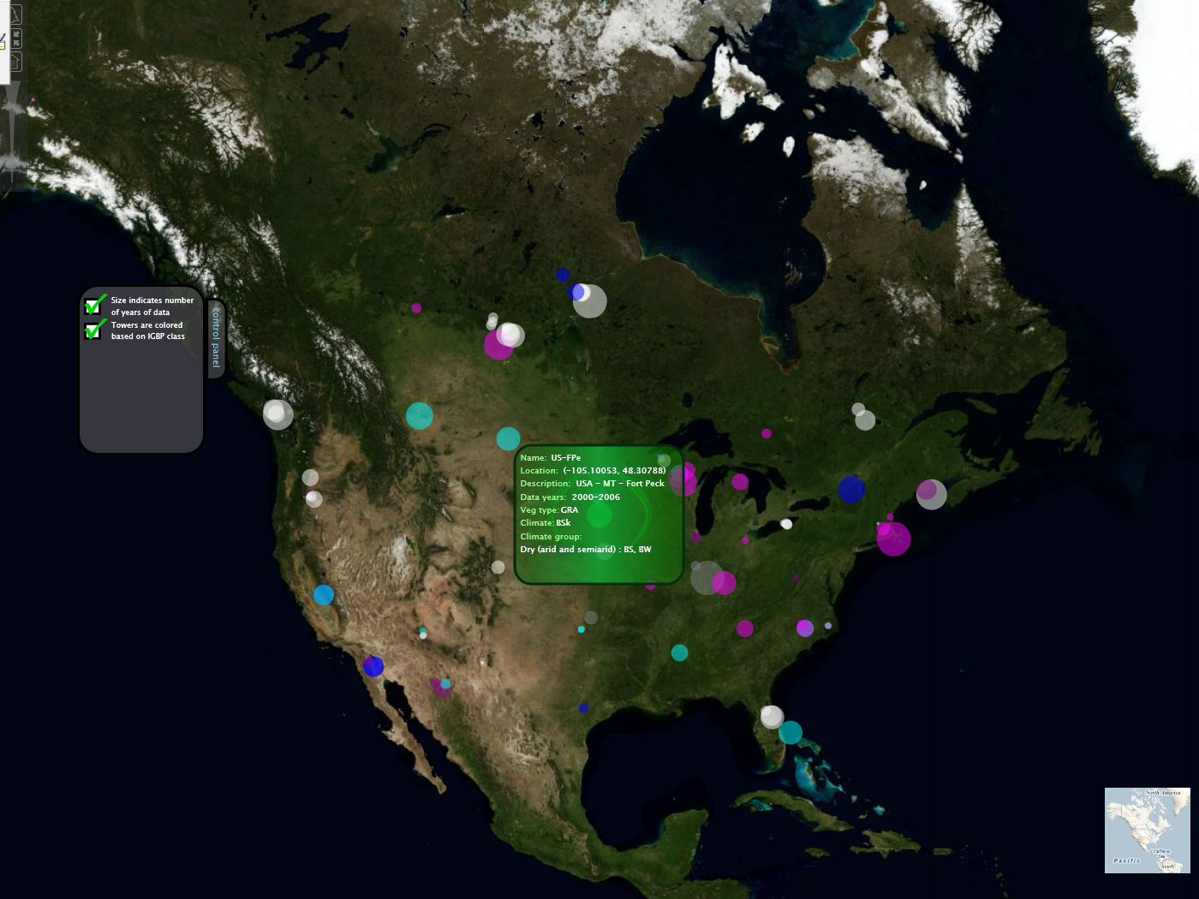
Mashup of Ameriflux Sites

Slide 27
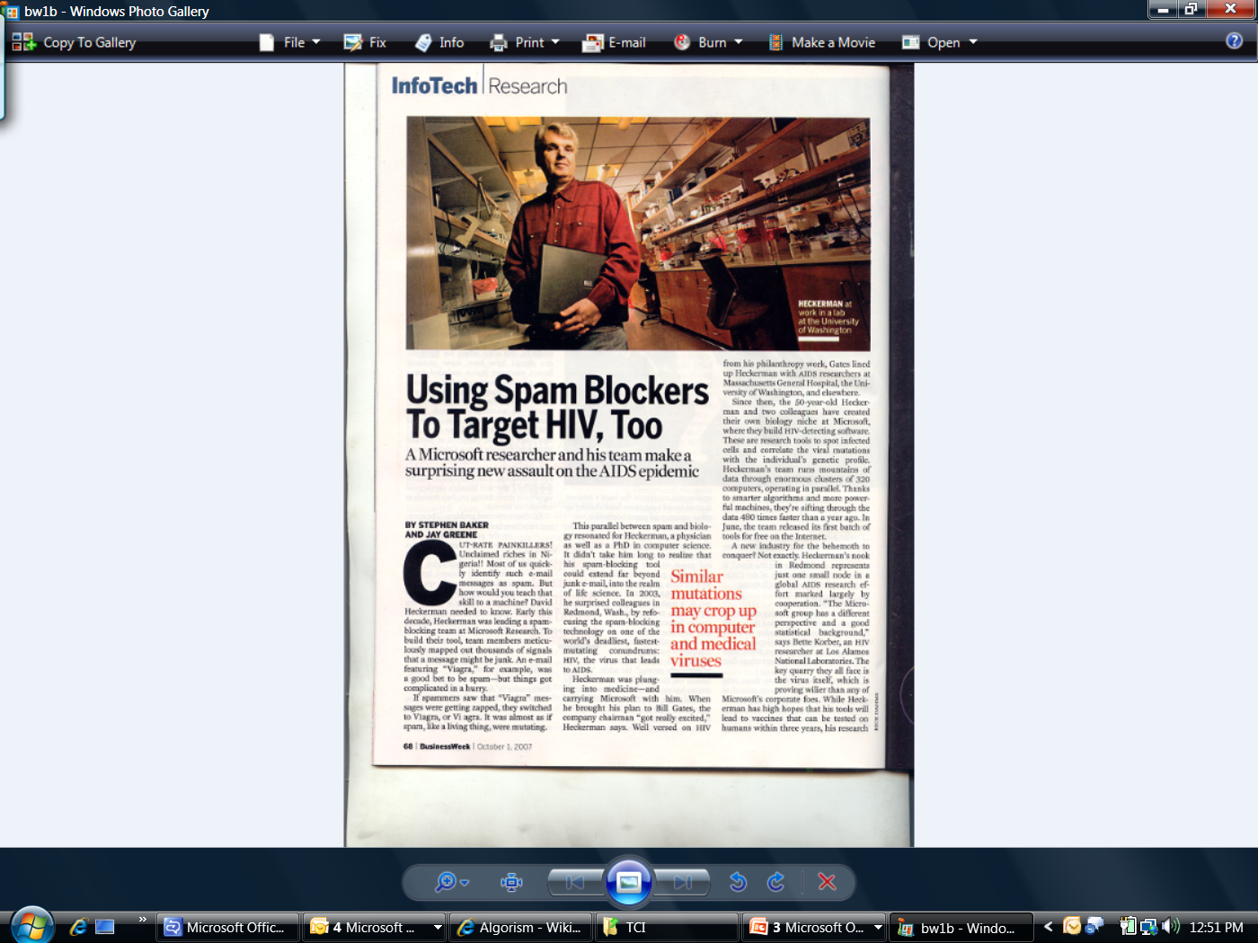

Slide 28

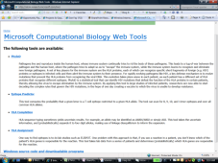
Computational Biology Web Tools
Better vaccine design through improved understanding of HIV evolution
Project Organization
Bruce Walker & Zabrina Brumme, Mass General
Philip Goulder, Oxford
Richard Harrigan, University of British Columbia
David Heckerman, Jonathan Carlson and Carl Kadie, MSR
Goals
Use machine learning and visualization tools developed at Microsoft, which require HPC, to build maps of within-individual evolution of the HIV virus
Proof Points
Discovered epitope decoys that could have predicted recent failure of Merck vaccine
Patent filed on new method for learning graphical models from data
Algorithms and medical results published in Science and Nature Medicine
MSR Computational Biology Tools published (Source on CodePlex)

Slide 29
Supporting researchers worldwide
Adding Semantics to Software Tools

Slide 30

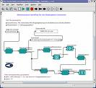
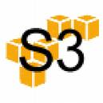








Research Pipeline
Data Acquisition & Modeling
Collaboration
Analysis
Disseminate & Share
Archiving
Data Acquisition and Modeling
  Data capture from source, cleaning, storage, etc.
  SQL Server, SSIS, Windows WF
Support Collaboration
  Allow researchers to work together, share context, facilitate interactions
  SharePoint Server, One Note 2007 (shared)
Data Analysis, Modeling, and Visualization
  Mining techniques (OLAP, cubes) and visual analytics
  SQL Analysis Services, BI, Excel, Optima, SILK (MSR-A)
Disseminate and Share Research Outputs
  Publish, Present, Blog, Review and Rate
  Word, PowerPoint
Archiving
  Published literature, reference data, curated data, etc.
  SQL Server
Microsoft has technologies that can offer end-to-end support

Slide 31
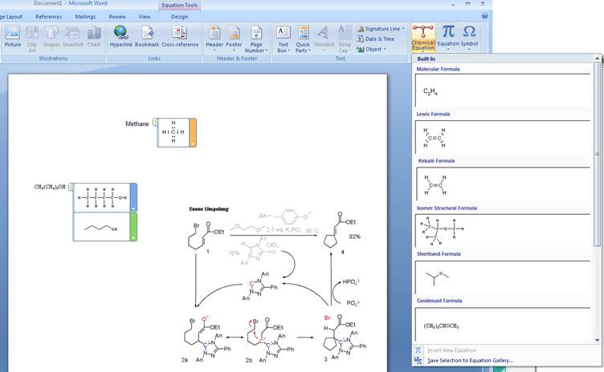
Data Acquisition & Modeling
Collaboration
Analysis
Disseminate & Share
Archiving
Chemistry Drawing for Office
Peter Murray Rust, Univ. of Cambridge
Murray Sargent, Office
Geraldine Wade, Advanced Reading Technologies
Goals
Support students/researchers in simple chemistry structure authoring/editing
Enable ecosystem of tools around lifecycle of chemistry-related scholarly works
Support the Chemistry Markup Language
Proof of concept plug-in
Execution
MSR Developer to work on the proof of concept
Post-doc in Cambridge to use plug-in and give feedback and move their chemistry tools to .NET and Office
Advanced Reading Technologies to create necessary glyphs

Slide 32
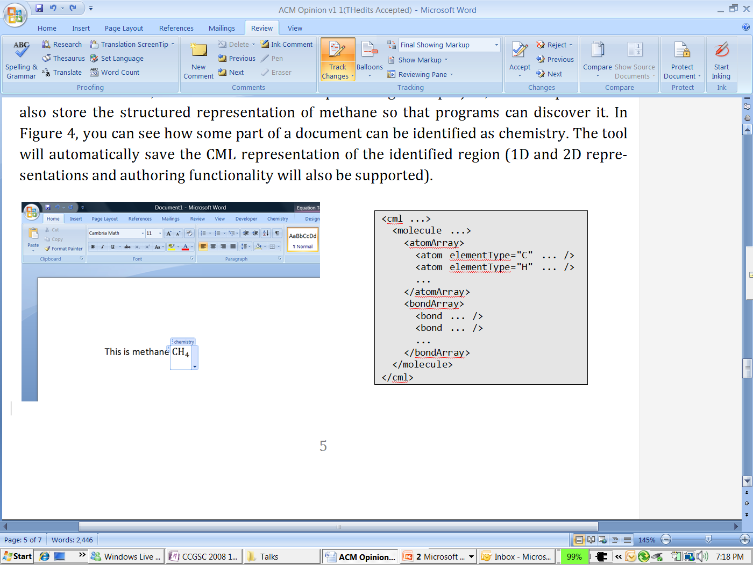
A “Chemistry Zone” in a Word document and the CML representation (in pseudo-XML) stored inside the OOXML document

Slide 33
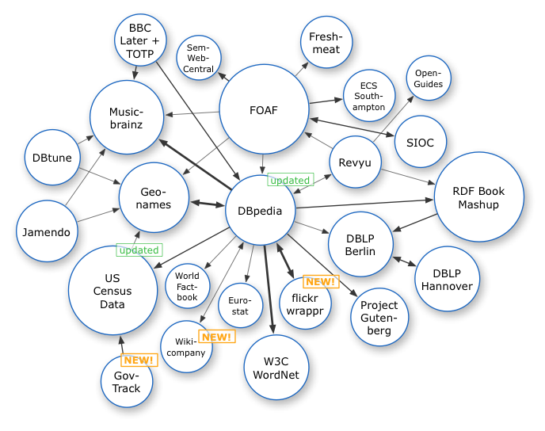
Data Acquisition & Modeling
Collaboration
Analysis
Disseminate & Share
Archiving
Semantic Annotations in Word
Phil Bourne and Lynn Fink, UCSD
Goals
Semantic mark-up using ontologies and controlled vocabularies
Facilitate/automate referencing to PDB (and other resources) from manuscript
Conversion of manuscript to NLM DTD for direct submission to publisher
Scenario
Authors do not need to be aware of the use of semantic technologies
A domain-specific ontology is downloaded and made available from within Microsoft Word 2007
Authors can record their intention, the meaning of the terms they use based on their community’s agreed vocabulary
Attribution: Richard Cyganiak

Slide 34
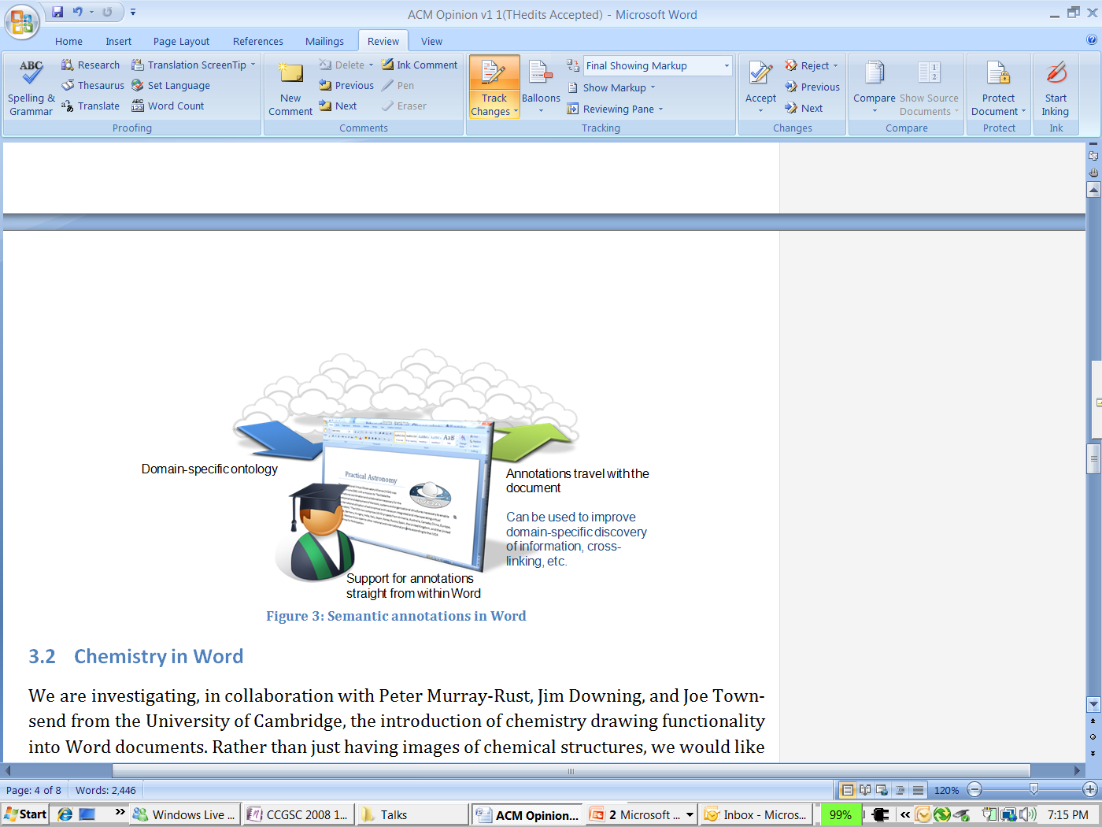
Semantic annotations in Word

Slide 35
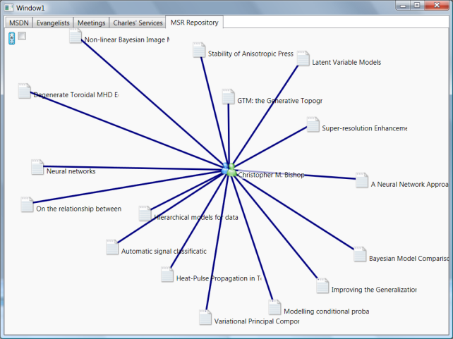
Data Acquisition & Modeling
Collaboration
Analysis
Disseminate & Share
Archiving
Research Output Repository
Famulus
UIs
Desktop Tools
Syndication
Interop
Search
A platform for building services and tools for research output repositories
Papers, Videos, Presentations, Lectures, References, Data, Code, etc.
Relationships between stored entities
Goals
Support the MSR publishing and dissemination platform for all researcher outputs
Enable a tools and services ecosystem for “research output” repositories on MS technologies
Execution
Support Eprints and Dspace front ends
Deployment within MSR early Q2
Release to the community late Q2
Built on SQL Server 2008 + Entity Framework

Slide 36
Research Output Repository Platform
A Semantic Computing platform
A hybrid between a relational database and a triple store
Triple stores
Evolution friendly
Poor performance
No need to model everything in advance
Semantic interpretation at the application level
Relational schema
Evolution not so easy
Great opportunities for optimization
Model everything in advance
Research Output Repository Platform
Maintain a balance
Try to model the frequently used entities in our app domain
Try to capture the frequently used relationships
Allow for extensibility (Relationships, Properties)

Slide 37

Research Output Repository Platform
PDF file
Lecture on 2/19/2008
is representation of
contains
PowerPoint presentation
authored by
organized by
presented by
tony
Elizabeth, Sebastien,
Matthew, Norman,
Brian, Sarah, George, Roy

Slide 38
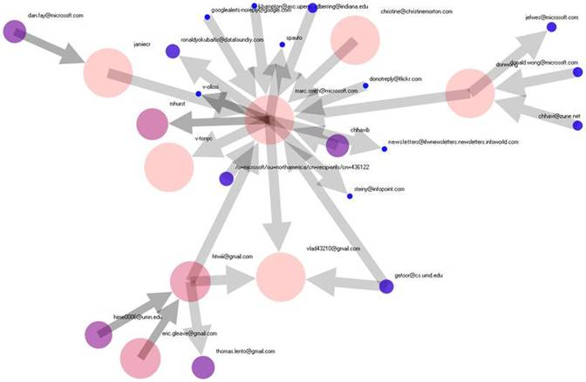
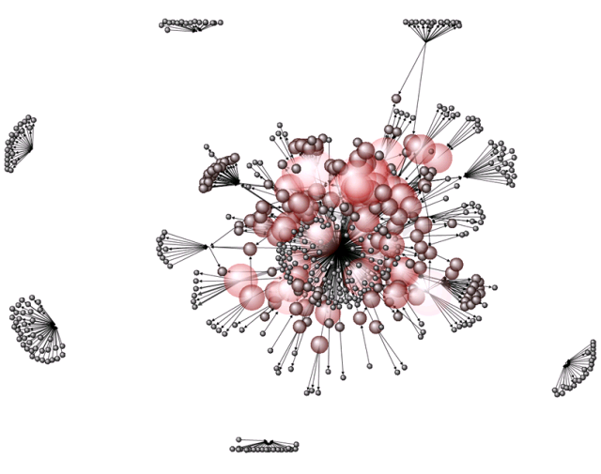
Data Acquisition & Modeling
Social Networking & Collaboration
Data Analysis and Visualization
Disseminate & Share
Archiving
.NET Map
Network Analysis Visualization
Project Organization
Marc Smith, Senior Research Sociologist (MSR)
Goals
Research in the visualization of interaction networks
Support for directed graphs
Relationship analysis
Proof Points
Standalone tools on Windows
Available as an Excel 2007 plugin

Slide 39
eScience and Semantic Computing meet the Cloud
The cyberinfrastructure for the next generation of researchers

Slide 40
The Future: Software plus Services for Science?
Expect scientific research environments will follow similar trends to the commercial sector
  Leverage computing and data storage in the cloud
  Scientists already experimenting with Amazon S3 and EC2 services, with mixed results
For many of the same reasons
  No resource sharing across different research labs
  High storage costs
  Low resource utilization
  Excess capacity
  High costs of reliably keeping machines up-to-date
  Need less support for developers, system operators

Slide 41
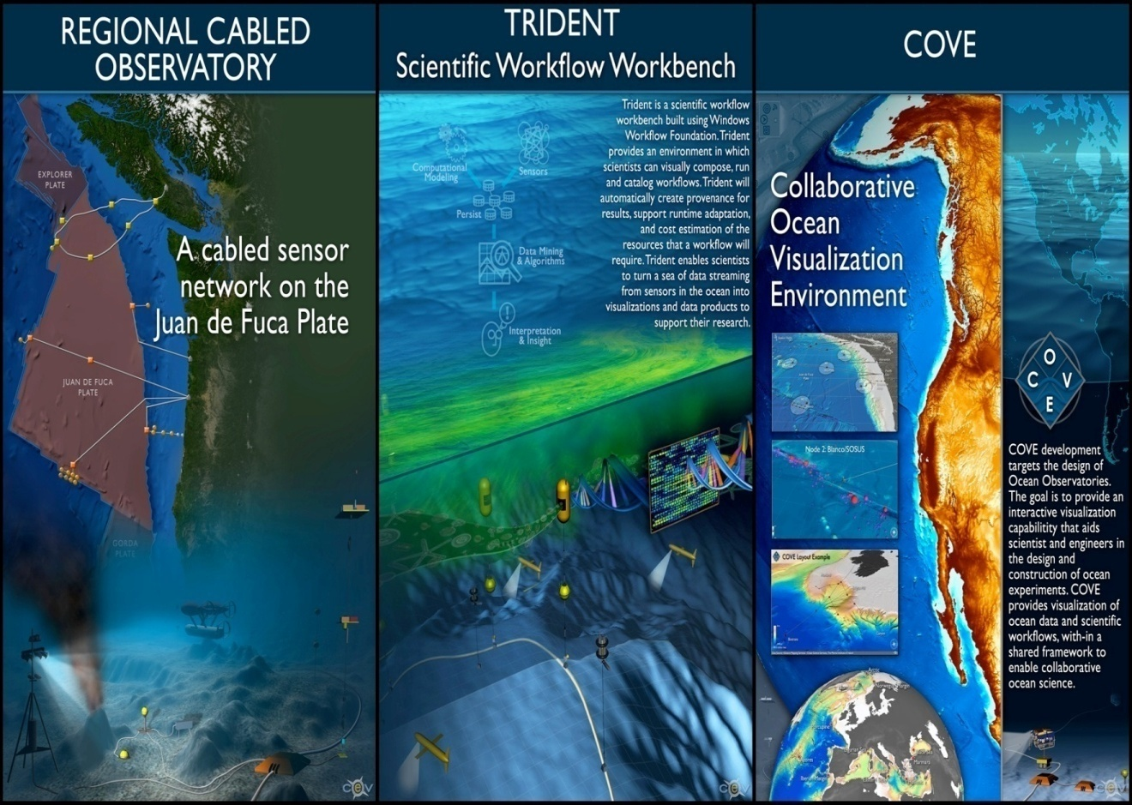
Trident – Scientific Workbench
Workflow for
Ocean Observatories,
part of an
“oceanographer’s
workbench”
Jim Gray
http://www.microsoft.com/mscorp/tc/trident.mspx

Slide 42
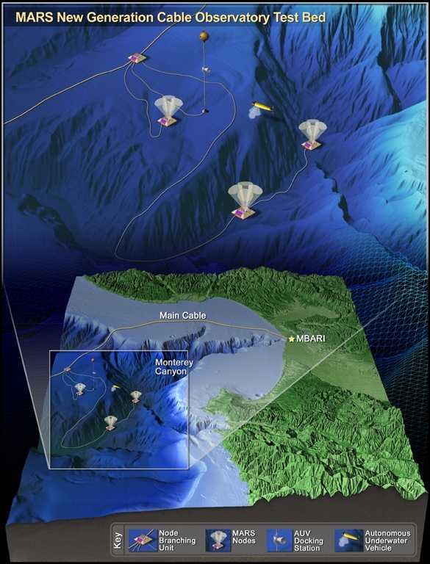




Data Acquisition & Modeling
Collaboration
Analysis
Disseminate & Share
Archiving
Trident Scientific Workflow Workbench
Univ. of Washington and Monterey Bay Aquarium Research Institute
Scientific workflow workbench to automate the data
processing pipelines of the world’s first plate-scale
undersea observatory
Goals
From raw data to useable data products
Focusing on cleaning, analysis, re-gridding, interpolation
Support real time, on-demand visualizations
Custom activities and workflow libraries for authoring
Visual programming accessible via a browser
Trial Cloud Services for science
Proof Points
A scientific workflow workbench for a number of science projects, reusable workflows, automatic provenance capture.
Demonstrate scientific use of Windows WF, HPCS, SQL Server and Cloud Service SSDS

Slide 43
Towards a smart cyberinfrastructure?
Collective intelligence
  If last.fm can recommend what song to broadcast to me based on what my friends are listening to, the cyberinfrastructure of the future should recommend articles of potential interest based on what the experts in the field that I respect are reading?
  Examples are emerging but the process is presently manual (Connotea, BioMedCentral Faculty of 1000 ...)
Semantic Computing
  Automatic correlation of scientific data
  Smart composition of services and functionality
Cloud computing to aggregate, process, analyze and visualize data

Slide 44
A world where all data is linked…
Data/information is inter-connected through machine-interpretable information (e.g. paper X is about star Y)
Social networks are a special case of ‘data meshes’
Important/key considerations
  Formats or “well-known” representations of data/information
  Pervasive access protocols are key (e.g. HTTP)
  Data/information is uniquely identified (e.g. URIs)
  Links/associations between data/information
Attribution: Richard Cyganiak

Slide 45




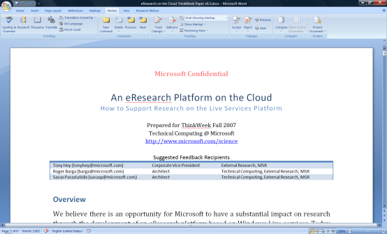

…and stored/processed/analyzed in the cloud
visualization and analysis services
Vision of Future Research
Environment with both
Software + Services
scholarly communications
domain-specific services
search
books
citations
blogs &
social networking
Reference management
instant messaging
Project management
identity
mail
notification
document store
storage/data services
The Microsoft Technical Computing mission to reduce time to scientific insights is exemplified by the June 13, 2007 release of a set of four free software tools designed to advance AIDS vaccine research. The code for the tools is available now via CodePlex, an online portal created by Microsoft in 2006 to foster collaborative software development projects and host shared source code. Microsoft researchers hope that the tools will help the worldwide scientific community take new strides toward an AIDS vaccine. See more.
knowledge management
compute
services
virtualization
knowledge discovery

Slide 46
Acknowledgements
The ideas presented here were developed with input from many colleagues in the community and at Microsoft Research:
  Thanks are due to David De Roure, Jeremy Frey, Carole Goble, Peter Murray-Rust, Alan Rector, Nigel Shadbolt and Alex Szalay
  And special thanks to Roger Barga, Savas Parastatidis and Evelyne Viegas at Microsoft Research who have tried to educate me …
See www.microsoft.com/science for some more details of Microsoft’s activities in Scientific and Technical Computing

Slide 47


