Slide 1

What Fran’s Thinking About: Digital data: From here to eternity
Dr. Francine Berman
Director, San Diego Supercomputer Center
Professor and High Performance Computing Endowed Chair,
UC San Diego

Slide 2
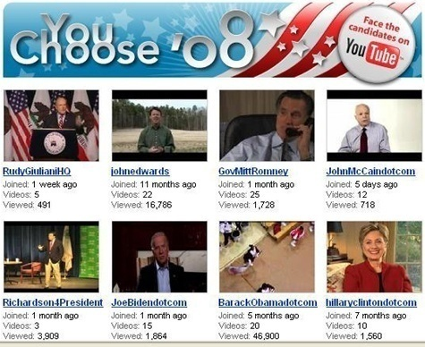
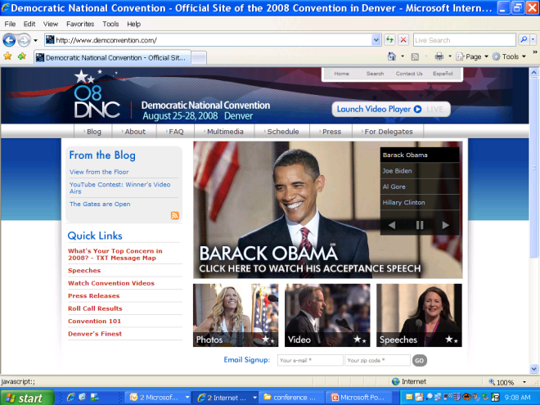
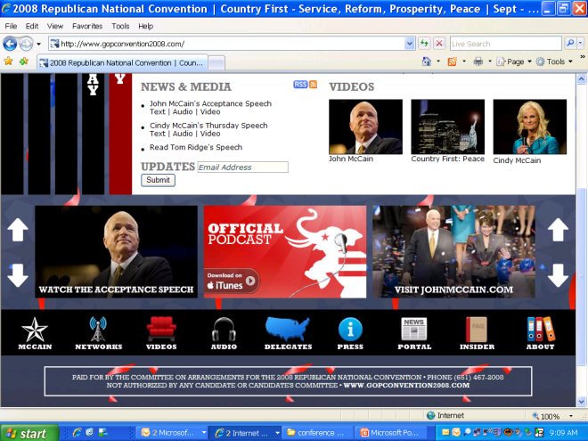
Our Digital World 1
The 2008 Cyber-election
  Fundraising via website
  YouTube videos of the candidates and conventions
  Blogs as vehicles for discussing issues
  On-line organizing
Digital data from historic 2008 cyber-election will be valuable for decades+ to come

Slide 3

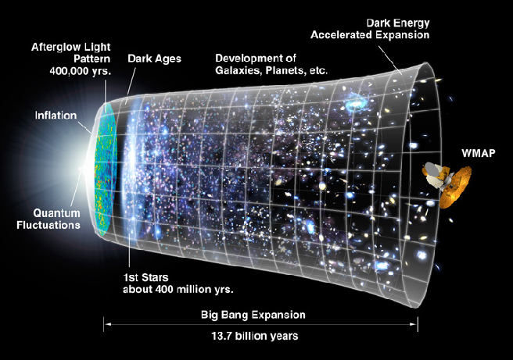
Our Digital World 2
The First Billion Years After the Big Bang
  400 TB of data produced from ENZO astrophysics simulations
  Data will be mined and analyzed, of great value for several years after computation
Simulation results illustrate growth of stars, galaxies, and galaxy clusters, dark matter, etc. after the Big Bang
Large-scale simulations “refreshed” as resources become available
Images courtesy of Mike Norman

Slide 4
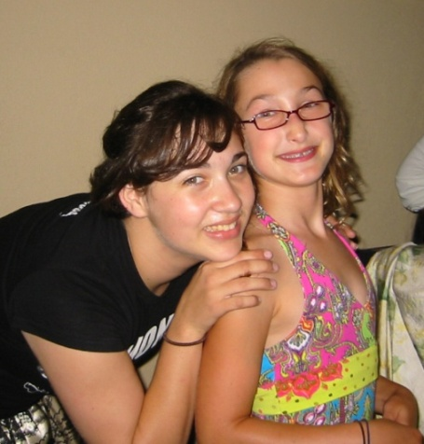
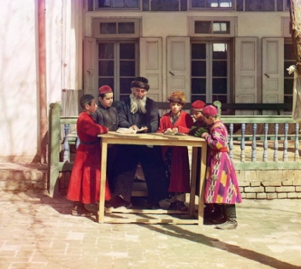
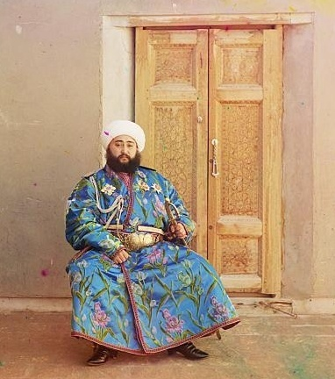
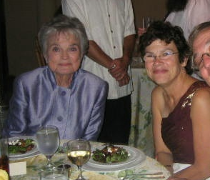
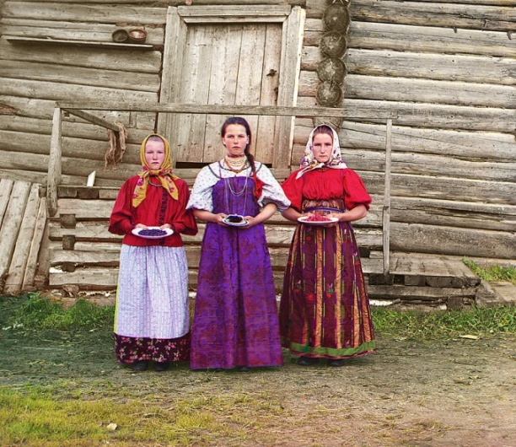
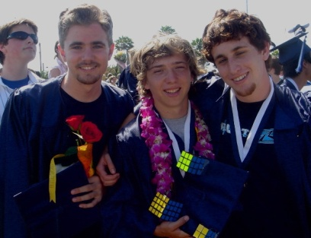
Our Digital World 3
Family Photographs
Some images courtesy of David Minor and the Library of Congress

Slide 5
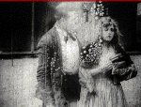
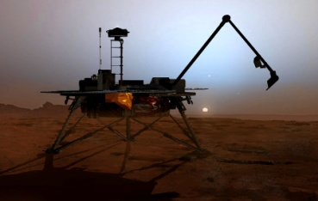
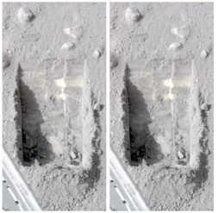
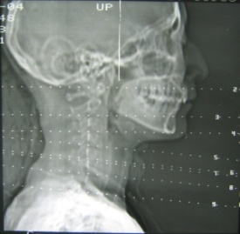
Sustainable Preservation of Digital Materials is a
Grand Challenge of the Information Age
Digital preservation presents some of the greatest challenges for Cyberinfrastructure
  Greater emphasis on system reliability and security required
  Smooth migration of digital materials from one generation of technology to the next critical
  Indexing/organizing structures and associated meta-information must support current and support future search and use modes, policy
  and regulation, etc.
  Data preservation efforts must be sustainable over the long-term (decades to centuries+)
Movies
Space
exploration
Health

Slide 6
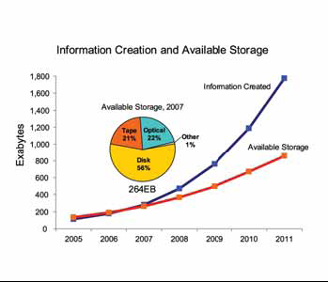
Running Out of Room
Increasing requirements for data retention in private, public, academic sectors render data infrastructure and preservation policies more critical. Many are currently “unfunded mandates”.
However, even if we wanted to, we can’t save everything: 2007 was the “crossover year” where the amount of digital information became greater than the amount of available storage
Source: “The Diverse and Exploding Digital Universe” IDC Whitepaper, March 2008

Slide 7
Data Preservation
Key Questions:
  What should we save? – policy, regulation
  How should we save it? – technology, best practice
  Who should pay for it? -- economics
Value
Cost
Time
Key candidates for preservation

Slide 8
Business Regulation
Requiring Data Preservation
Sarbanes-Oxley (Public Accounting Reform and Investor Protection Act of 2002)
Applies to all U.S. public company boards, management, and public accounting firms
Includes electronic records (correspondence, work papers, memoranda, etc.) that are created, sent, or received in connection with an audit or a review)
  Section 103: “Board must require registered public accounting firms to “prepare, and maintain for a period of not less than 7 years, audit work papers, and other information related to any audit report, in sufficient detail to support the conclusions reached in that report.”
  Section 802: “any accountant who conducts an audit of an issuer of securities to which section 10(a) of the SEC …applies, shall maintain all audit or review work papers for a period of 5 years from the end of the fiscal period in which the audit or review was concluded.”
“Don’t forget that email and instant messaging are business records …
Don't assume that the retention requirement …is …7 years. There are a lot of variables depending on the industry, type of organization and type of information. … most lawyers that understand information retention agree that business records need to be kept indefinitely.
Don’t assume that just because you have access to archived information that you’re going to be able to restore it within a reasonable amount of time…”
Kevin Beaver, “Thirteen Data Retention Mistakes to Avoid” http://searchdatamanagement.techtarget.com/news/article/0,289142,sid91_gci1186910,00.html

Slide 9
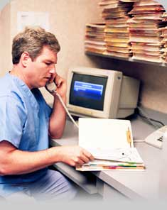
Health Regulation
Requiring Data Preservation
HIPAA (Health Insurance Portability and Accountability Act)
Applies to health information created or maintained by health care providers “who engage in certain electronic transactions, health plans, and health care clearinghouses” [www.hipaa.org]
Title II: Requires HHS to create rules and standards for the use and dissemination of health care information
Healthcare providers must retain healthcare records for a period of not less than 6 years.
Table information partly based on “Data Retention – More Value, Less Filling”,
John Murphy, http://www.tdan.com/view-articles/5222

Slide 10
Increasing Policy and Regulation
Affecting Research Community
  OMB requires that federally funded research data, supporting documentation, scientific notebooks, financial records, etc. be maintained by the grantee for 3+ years
  University libraries, federal agencies, institutional repositories not currently prepared to address the economic, technological, legal and social issues associated with widespread compliance of data retention policies
Crime and Punishment
Regulations | Retention Requirement | Penalty
HIPAA | Retain patient data for 6 years | $250K fine and up to 10 years in prison
Sarbanes-Oxley | Auditors must retain relevant data for at least 7 years | Fines to $5M and 20 years in prison
Gramm-Leach-Baily | Ensure confidentiality of customer financial information | Up to $500K and 10 years in prison
SEC 17a | Broker data retention for 3-6 years. Some require longer retention | Variable based on violation
OMB Circular A-110 / CFR Part 215 (applies to federally funded research data) | “a three year period is the minimum amount of time that research data should be kept by the grantee” | Penalty structure unclear, likely fines?
Table information partly based on “Data Retention – More Value, Less Filling”,
John Murphy, http://www.tdan.com/view-articles/5222

Slide 11
How Should We Save It?
Technology: Increasing activity around data storage and preservation technologies, programs, and services
Academic sector:
  IRODS (rule-based distributed data management), Fedora (digital object repository system), D-Space (digital asset management), LOCKSS (peer-to-peer digital preservation infrastructure), etc.
Private sector: Amazon, MS, Google, Apple, Flickr, Sun, etc.
Public Agencies/Institutions: Library of Congress, NARA, NSF, NIH, DOE, Museums, Libraries, universities, state governments, etc.
However, there is no technology magic bullet …
Preserving digital data 100+ years will involve
  Tens-hundreds of new generations of technologies
  Thousands+ of new data standards and formats
  Millions+ of new valued collections
  Billions+ of potential users with as yet unknown information needs and workflows

Slide 12
Librarians’ Perspective: People, Planning, Protections Critical Focus for the Preservation Environment
Centers of Expertise
A Sample View of the
Library of Congress
Stewardship Network
Automatic Ingest
& Metadata
Mass
Storage
Discovery and
Humanities and Sciences
Agreements
Auditing
Navigation
Content
NETWORK ENVIRONMENT
User
Plan
NETWORK SERVICES
Data
Creator
Rights
Manager
ORGANIZATIONAL FUNCTIONS
Advocacy
Archiver / Custodian
Owner
Ingest /
Deposit
Tools
ROLES
R & D
Cataloger
Distributor
NETWORK MANAGEMENT
Metadata
Selector
Secure
Storage
Content Authentication
Training
Public
Policy
Accreditation
Formal
Registry
Content
Directory
Standards
Figure courtesy of Martha Anderson, Library of Congress

Slide 13
Research and Education User’s Perspective:
Key Questions Focus on Outcomes rather than Technology
How can I combine my data with my colleague’s data?
How do I make sure that my data will be there when I want it?
How should I organize my data?
What are the trends and what is the noise in my data?
My data is confidential; how do I make sure that it is seen/used only by the right people?
How should I display my data?
How can I make my data accessible to my collaborators?

Slide 14
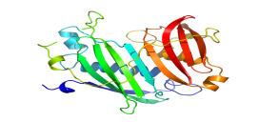

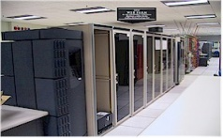
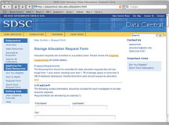
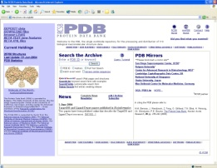

CI Perspective: Key Questions Focus on Integration, Capability, Usability, Reliability, Interoperability
analysis
modeling
Integrated Cyberinfrastructure
SERVICES
Database selection and schema design
Portal creation and collection publication
Data analysis
Data mining
Data hosting
Preservation services
Domain-specific tools
  Biology Workbench
  Montage (astronomy mosaicking)
  Kepler (Workflow management)
Data visualization
Data anonymization, etc.
Data Access
simulation
visualization
Data Manipulation
Data Management
File systems,
Database systems,
Collection Management
Data Integration, etc.
Data Storage
instruments
Many Data
Sources
Sensor-
nets
computers

Slide 15
Current Best Practices in Digital Preservation
Replication – make multiple copies and store some off-site
Heterogeneity – more bio-diverse solutions tolerate greater error
Associate metadata with data to aid access, management, search
Plan ahead for smooth transition of data to new generations of media
Align necessary level of “trust” with reliability, infrastructure
Include data costs as part of the IT bill
Pay attention to security
Know the appropriate regulations, policies, and penalties that pertain to your data
Why are 3 copies used as best practice?
Approach comes from Lamport, Shostak, and Pease’s solution to the Byzantine General’s Problem
  Method for agreement on a battle plan for a group of Byzantine generals communicating only by messenger
  Analogous to reliable computer systems with malfunctioning components
Solution: When generals can send unforgeable signed messages to one another, the minimum number required for agreement is 3.

Slide 16

Preservation Data Grid
The Chronopolis Model
Geographically distributed preservation data grid
  supports long-term management, stewardship of, and access to digital collections
Focus: technological, human, and policy infrastructure for preservation and life cycle management through multiple technology generations
Chronopolis “users” = data stewards
Distributed Production
Preservation Environment
Digital
Information
of Long-Term
Value
Technology
Forecasting and
Migration
Administration,
Policy,
Outreach
http://chronopolis.sdsc.edu/

Slide 17
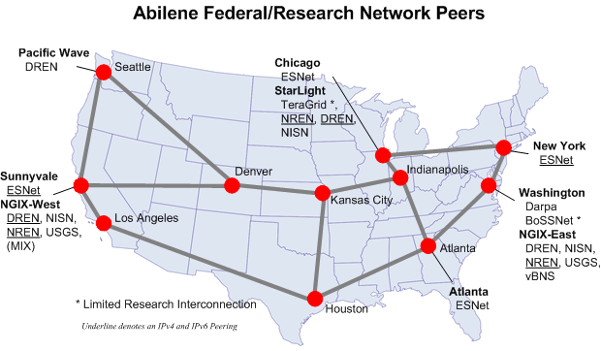
Data Replication and Distribution
Focus on supporting multiple, geographically distributed copies of preservation collections:
  “Bright copy” – Chronopolis site supports ingestion, collection management, user access
  “Dim copy” – Chronopolis site supports remote replica of bright copy and supports user access
  “Dark copy” – Chronopolis site supports reference copy that may be used for disaster recovery but no user access
Each site may play different roles for different collections
Chronopolis Federation architecture
NCAR
U Md
Dim copy C1
Dark copy C1
Dark copy C2
Bright copy C2
Bright copy C1
SDSC
Dim copy C2
Chronopolis Site
Project Partners: SDSC, UCSD Libraries, NCAR, University of Maryland
Sponsoring Agency: Library of Congress
Data Partners: ICPSR, CDL, Library of Congress, NCAR, NVO

Slide 18
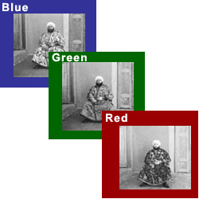

Technology and Preservation: Hard Questions
Formalizing / quantifying “trust”, reliability, etc.
What is the “gold”, “silver”, “bronze” standard for data reliability?
What is the best approach for configuration / costing of data cyberinfrastructure at each level of reliability?
Risk management
How should risk of single failure (media
damage or corruption, natural disaster,
operator error, hacker, etc.) be avoided?
How much and what kind of data loss
can be mitigated?
Optimizing Use
What ontologies, metadata, and other structures
optimize current and future use-case scenarios
and policy/regulation
Prokudin-Gorskii Photographs
(Library of Congress Prints and Photographs Division)
http://www.loc.gov/exhibits/empire/
Library of Congress Pilot Project images and information courtesy of David Minor and LC

Slide 19
Who Should Pay?
The “Free Rider” Non-Solution
Inadequate/unrealistic approach: “Let X do it”
where X is:
  The Government
  The Libraries
  The Archivists
  Google, Yahoo,
  Microsoft, etc.
  Data users
  Data owners
  Data creators, etc.
Valued digital data is a “public good”
Creative partnerships needed to provide preservation solutions with
  Trusted stewards
  Feasible costs for users
  Sustainable costs for infrastructure
  Very low risk for data loss, etc.

Slide 20
Economic Sustainability Requires A Holistic Approach
The economists’ perspective: Economic sustainability for digital preservation is the set of business, social, technological and policy mechanisms that
  Encourage the gathering of important information assets into digital preservation systems
  Support the indefinite persistence of the digital preservation systems, securing access to and use of the information assets into the long term future.
Economically sustainable digital preservation requires
  Recognition of the benefits of preservation from decision makers
  Appropriate incentives to induce decision makers to act in the public interest
  Mechanisms to secure ongoing allocation of resources to digital preservation activities
  Efficient use of limited preservation resources
  Appropriate organization and governance of digital preservation activities.
Many Economic Models Possible:
Endowment
(data philanthropy)
Institutional subsidy
(data welfare)
Fee-based
  Membership /subscription
  Ingestion fees
  Access fees
  Fee per use
Advertising, etc.
Definition courtesy of Blue Ribbon Task Force on Sustainable Digital Preservation and Access

Slide 21

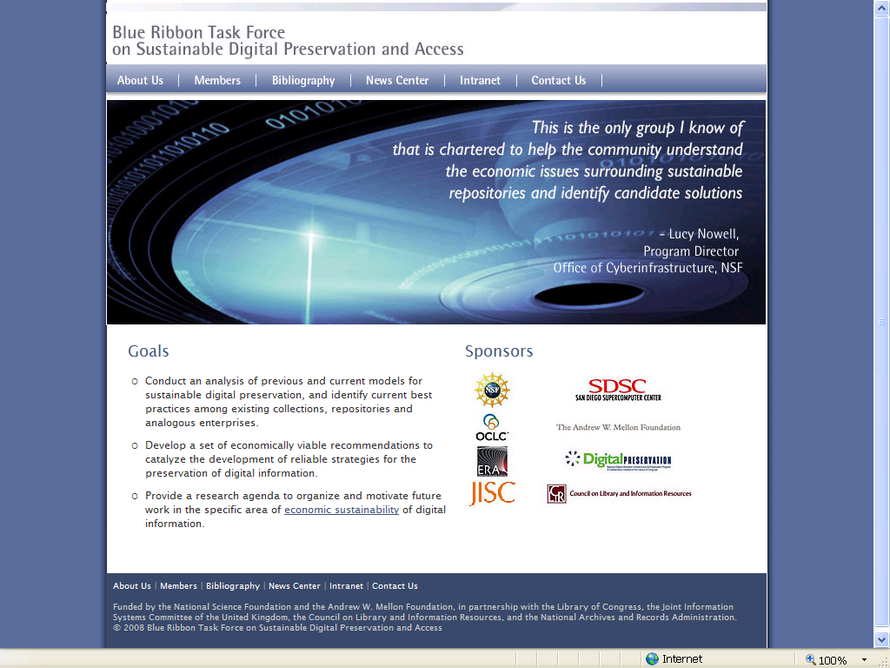
What Fran’s Thinking About:
Blue Ribbon Task Force on Sustainable Digital Preservation and Access
International Blue Ribbon Task Force (BRTF-SDPA) initiated to study issues of economic sustainability of digital preservation and access 2008-2009
Supported by NSF, Library of Congress, Mellon Foundation, NARA, JISC, CLIR, member institutions
BRTF-SDPA CHARGE
To conduct a comprehensive analysis of previous and current efforts to develop and/or implement models for sustainable digital information preservation
To identify and evaluate best practice regarding sustainable digital preservation among existing collections, repositories, and analogous enterprises
To make specific recommendations for actions that will catalyze the development of sustainable resource strategies for the reliable preservation of digital information
Provide a research agenda to organize and motivate future work.
Task Force website
brtf.sdsc.edu

Slide 22
BRTF-SDPA
Goal is to go beyond the “3 R’s”:
Data preservation is Really important
More Research is needed.
More Resources are needed.
Participants:
Paul Ayris, University College London
Fran Berman, SDSC/UCSD
Bob Chadduck, NARA Liaison
Sayeed Choudhury, Johns Hopkins
Elizabeth Cohen, AMPAS/Stanford
Paul Courant, University of Michigan
Lee Dirks, Microsoft
Amy Friedlander, CLIR
Chris Greer, NITRD Liaison
Vijay Gurbaxani, UC Irvine
Anita Jones, University of Virginia
Ann Kerr, Consultant
Brian Lavoie, OCLC
Cliff Lynch, CNI
Dan Rubinfeld, UC Berkeley
Chris Rusbridge, DCC
Roger Schonfeld, Ithaka
Abby Smith, Consultant
Anne Van Camp, Smithsonian
Deliverables
First Year (December, 2008) Report (positive, “what is”):
  Past and current models of economic sustainability for digital preservation
  Points of convergence/divergence; “lessons learned”;
  What do we know, where are the gaps?
Second Year (December, 2009) Report (normative, “what should be”):
  General cost framework: key cost categories of digital preservation
  Emodels/“scenarios”: alternate ways of organizing digital preservation activities
  Features, pros, cons, trade-offs, etc. of each model
  List real world conditions for which each model is best suited.
    “If your digital preservation context is X, we recommend you consider using model Y to organize your activities in a sustainable way.”

Slide 23
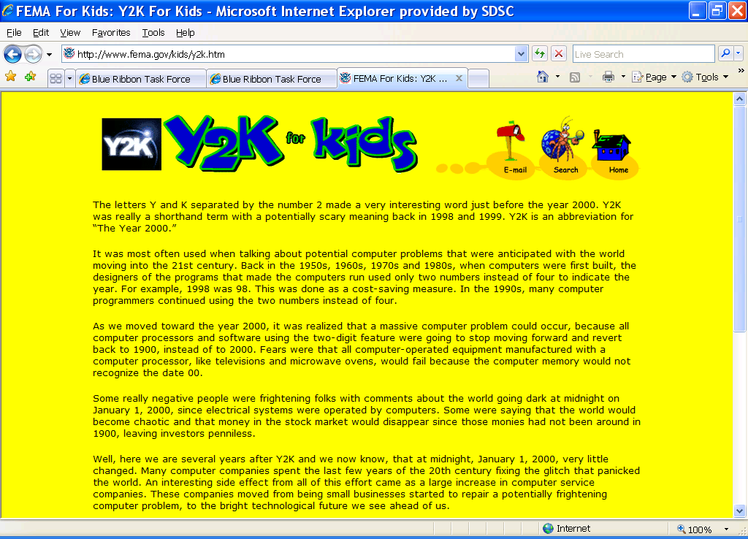
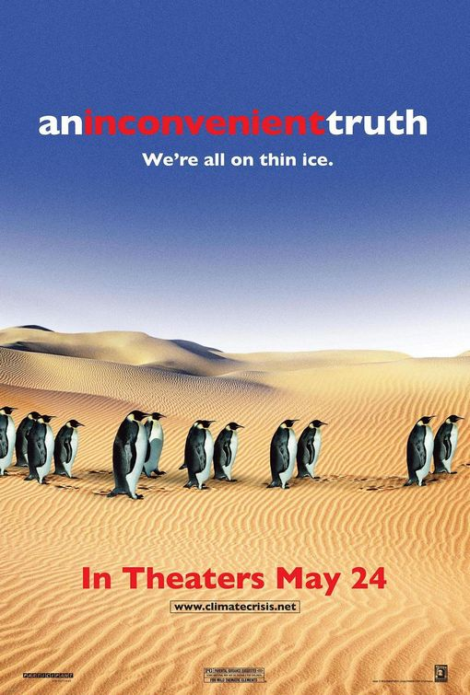
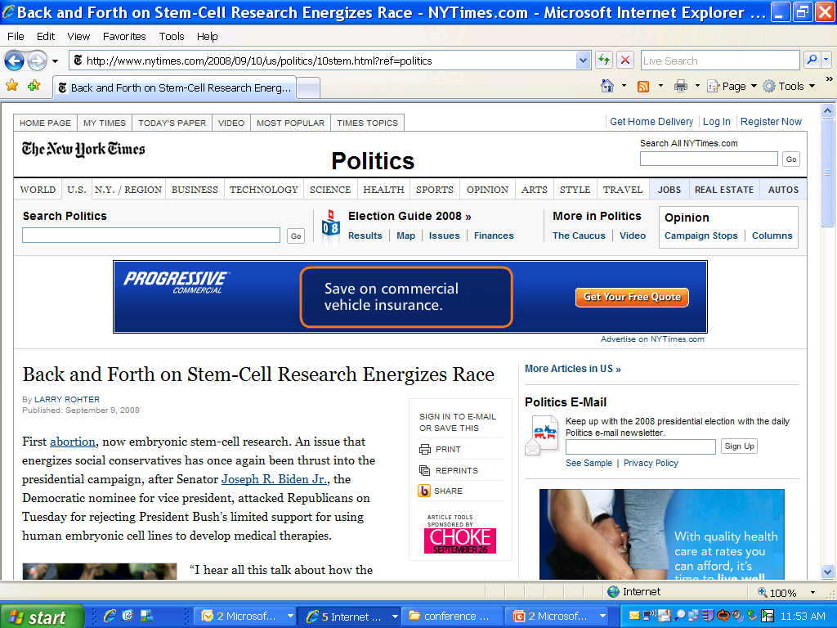
Call to Action: Focus Public Attention on the Need for Sustainable Digital Preservation and Cyberinfrastructure
Does your dry cleaner know what digital preservation is?
Public discussion needed to focus attention on data preservation and cyberinfrastructure.
When enough people think it’s important, resources and opportunity will follow.

Slide 24
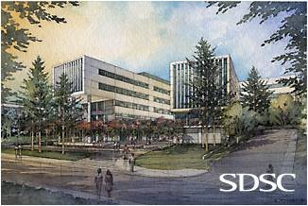
Thanks to Jack and Bernard for continuing this great tradition
Shameless plug:
Next Generation SDSC
mission, leadership, resources will be announced
October 14 at our new building dedication.
Please join us if you can!

