Slide 1
NAG and the BLAS
Mick Pont
Development Division
NAG Ltd, Oxford
May 19th 2016

Slide 2
NAG
Numerical Algorithms Group - Founded 1970
Co-operative software project: Birmingham, Leeds, Manchester, Nottingham, Oxford, and Atlas Laboratory
Inspired by Jim Wilkinson
Incorporated as NAG Ltd. in 1976
Not-for-profit
Based in Oxford, with offices in Manchester, Chicago, Tokyo
Mathematical algorithm development
Often collaborative
We also fund research students
Software engineering – production and porting of software libraries
HPC services and consultancy
Notes:
18-May-16
NAG Confidential
2

Slide 3
NAG Library Contents Overview
Sparse Linear Algebra
Correlation and Regression Analysis
Analysis of Variance
Random Number Generators
Univariate Estimation
Nonparametric Statistics
Smoothing in Statistics
Contingency Table Analysis
Survival Analysis
Time Series Analysis
Operations Research
Special Functions
Root Finding
Summation of Series
Quadrature
Ordinary Differential Equations
Partial Differential Equations
Numerical Differentiation
Integral Equations
Mesh Generation
Interpolation
Curve and Surface Fitting
Optimization
Dense Linear Algebra
BLAS, LAPACK

Slide 4
NAG and the BLAS
NAG Library is relatively high level, e.g.
mathematical optimization solvers
data fitting
But relies heavily on lower levels like linear algebra
User
Application
Compilers etc.
NAG Library
Core Math Lib
(BLAS and LAPACK)
Hardware

Slide 5
NAG Library Wraps NAG Engine
Fortran
Wrappers
C / C++
BLAS /
LAPACK
NAG Engine
(95% Fortran)
Wrappers auto-generated from XML doc
MATLAB mex
wrappers
Java
etc.
Python

Slide 6
Test programs
NAG library currently has about 1600 routines
Every routine has associated detailed documentation and example program
Also a “stringent test program”
For LAPACK routines these are independent of the netlib test programs
Ours are simpler and (hopefully) easier to extend
But we do also use the netlib ones

Slide 7
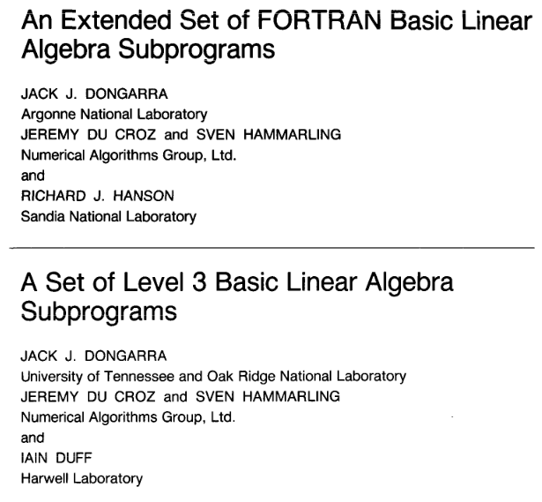
NAG and the BLAS

Slide 8
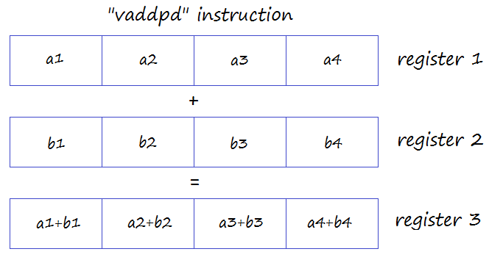
Reproducibility
SIMD instructions operate on several numbers at once
But to use these instructions memory alignment may be crucial …

Slide 9
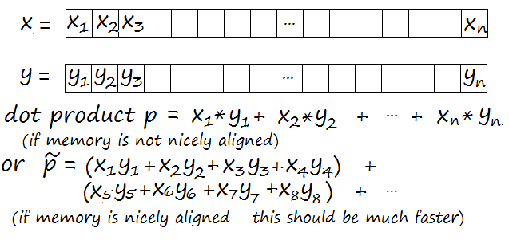
Example - dot product
Mathematically equivalent – but the two results are not necessarily identical. Does it matter? Sometimes …

Slide 10
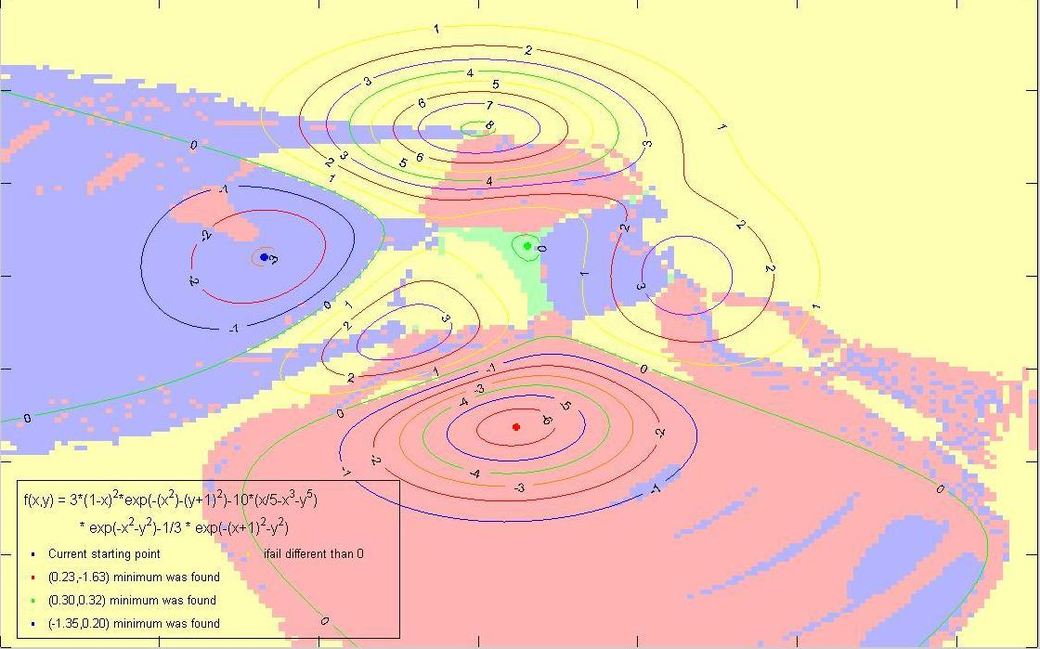
Local (mathematical) optimization
Nonlinear programming using a sequential quadratic programming (SQP) method

Slide 11
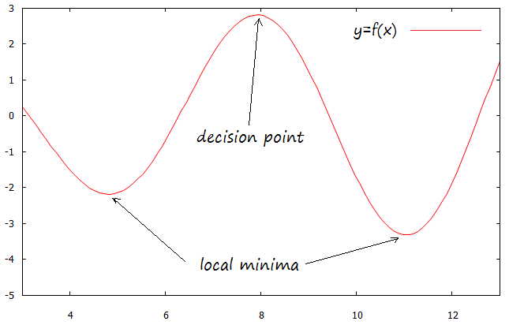
Local optimization
Without BWR – could go to one or other of the local minima on different runs of the same program on the same machine

Slide 12
Importance of BWR
Bit-Wise Reproducibility (BWR)
Essential for some users (e.g. in finance)
They may need to explain even minor differences
Sometimes no amount of discussion can change their minds!
NAG users spot problems
e.g. with local optimization
e.g. with statistical analyses wrongly perceived by them as using stochastic algorithms

Slide 13
Some things added in recent NAG versions
Usually added in response to customer demand
Matrix functions
Mixed integer nonlinear programming
Change point analysis
Travelling salesman problem

Slide 14
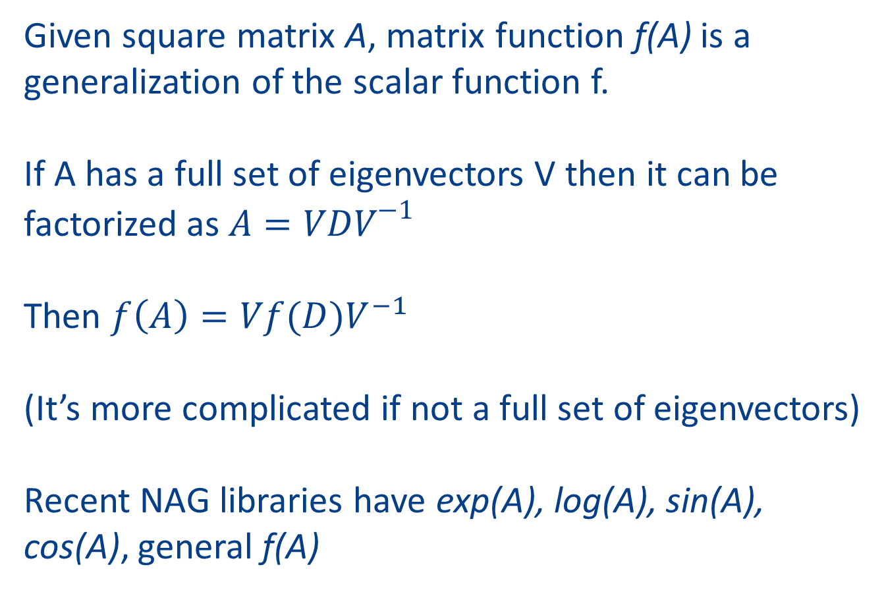
Matrix Functions (work by Higham et al)
Given square matrix A, matrix function f(A) is a generalization of the scalar function f.
If A has a full set of eigenvectors V then it can be factorized as $A=VDV^{−1}$
Then $f\left(A\right)=Vf(D)V^{−1}$
(It’s more complicated if not a full set of eigenvectors)
Recent NAG libraries have exp(A), log(A), sin(A), cos(A), general f(A)

Slide 15
BLAS-like routines that would be useful to us
Routines to multiply triangular matrices:
=
x
=
x
(xTRMM routines allow only one matrix to be triangular)
Used a great deal in computing matrix functions
Also useful in statistical applications

Slide 16


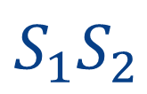
BLAS-like routines that would be useful to us
Multiplication of two symmetric matrices:
$$S_{1}S_{2}$$
Perhaps single-call pre- and post-multiplication:
$$X^{T}SX$$
where $X$ is general and $S$ is symmetric
Such operations also used a lot in statistical calculations
e.g. time series analysis

Slide 17

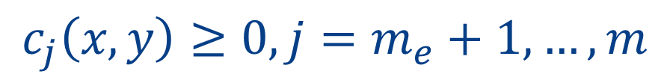
H02DA – Mixed Integer Nonlinear Programming
$$minimize f\left(x,y\right)$$
(general nonlinear function)
$$subject to c_{j}\left(x,y\right)=0, j=1,2,…m_{e}$$
$$c_{j}\left(x,y\right)≥0, j=m_{e}+1, …, m$$
$x −$continuous variables (i.e. any real number)
$y −$binary (0/1) or integer variables (i.e. whole numbers)

Slide 18
H02DA – Mixed Integer Nonlinear Programming
H02DA is based on the algorithm MISQP
Exler, Lehmann, Schittkowski
Uses a modified SQP algorithm
Solves a sequence of QP problems
Some advantages:
Tends to use few function evaluations
Unlike genetic algorithms
Integer variables are not assumed relaxable
i.e. the objective function is only evaluated at integer points y

Slide 19
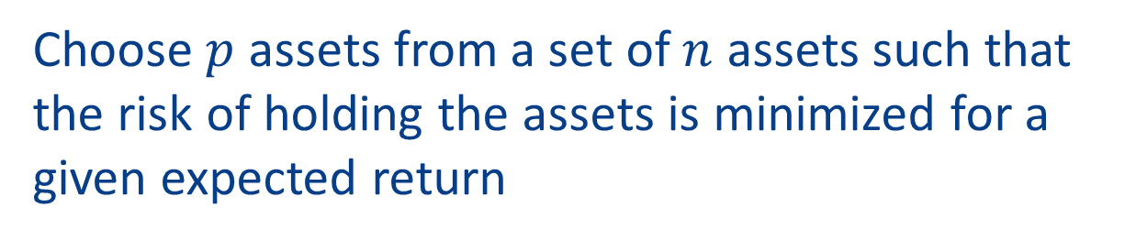
H02DA – Mixed Integer Nonlinear Programming
Example from portfolio optimization:
Choose $p$ assets from a set of $n$ assets such that the risk of holding the assets is minimized for a given expected return
Other examples:
Network design for water or gas distribution
Operational reloading of nuclear reactors

Slide 20
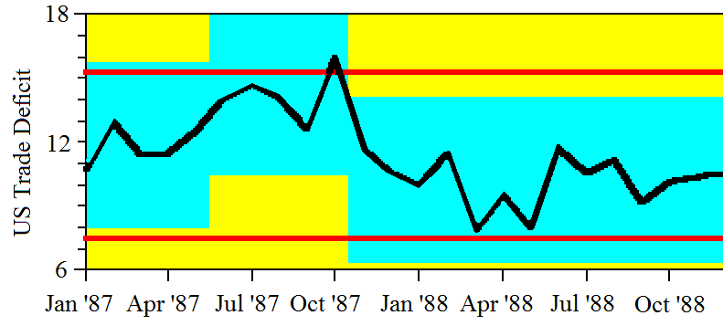
G13N – Change Point Analysis
G13N – Change Point Analysis
Detect points in a univariate time series where some feature of the data (e.g. the mean or standard deviation) changes
G13NA - PELT algorithm by R Killick, P Fearnhead and IA Eckely
PELT - Pruned Exact Linear Time
G13ND - Binary segmentation

Slide 21
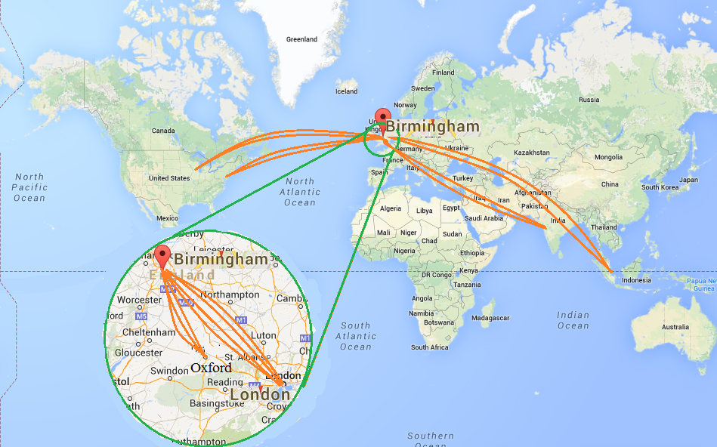
H03BB – Travelling Salesman Problem
Typical NAG salesman's path:
Birmingham --> London --> Birmingham --> Oxford
--> Birmingham --> London --> Birmingham --> New York
--> Birmingham --> London --> Birmingham --> Oxford
--> Birmingham --> Chicago --> Birmingham --> London
--> Birmingham --> Oxford --> Birmingham --> Mumbai -->...
Total distance travelled : endless

Slide 22
H03BB – Travelling Salesman Problem
Given a set of places and the distances between them, e.g.
Oxford Birmingham Warwick Singapore New York Chicago Mumbai London
78 45 6785 3397 3892 4523 60 : Oxford
26 6778 3380 3849 4545 101 : Birmingham
6783 3383 3867 4531 82 : Warwick
9519 9359 2422 6733 : Singapore
711 7789 3459 : New York
8047 3947 : Chicago
4468 : Mumbai
: London
calculate something near the shortest closed path that connects each place

Slide 23
H03BB – Travelling Salesman Problem
Greedy algorithm – always go to nearest unvisited place – usually gets within 25% of best solution (but could be the worst solution)
H02BB instead uses a simulated annealing approach
new states tested by switching pairs of places in a path
Optimal path for previous slide computed by H03BB:
Oxford --> London --> Mumbai --> Singapore --> Chicago
--> New York --> Birmingham --> Warwick --> Oxford
Total distance travelled : 20471 miles
Saving on typical NAG salesman expenses : large

Slide 24

POP - Performance Optimisation and Productivity
NAG is partner in the EU-funded POP Centre of Excellence
Performance optimisation advice for parallel codes:
Suggestions/support on how to refactor code in the most productive way
Enable improved efficiency, better utilisation of HPC resources
Supporting wide range of languages (C, C++, Fortran, OpenMP, MPI, Cuda, …)
Free of charge to organisations in the EU
We hope that batched BLAS can play a part
Education is key
Website: https://pop-coe.eu

