Slide 1

High-Performance Batched Computations
Azzam Haidar
Innovative Computing Laboratory
University of Tennessee, Knoxville
In collaboration with:
LLNL, Livermore, CA, USA
University of Manchester, Manchester, UK
University of Paris-Sud, France
May 18–19, 2016

Slide 2
Outline
Motivation
Current approaches and challenges
MAGMA Batched computations
  Algorithmic basics
  Design and optimizations for batched computations
  LU, QR, and Cholesky
  Performance results
  Energy efficiency
MAGMA Batched computations for variable sizes
Future direction

Slide 3
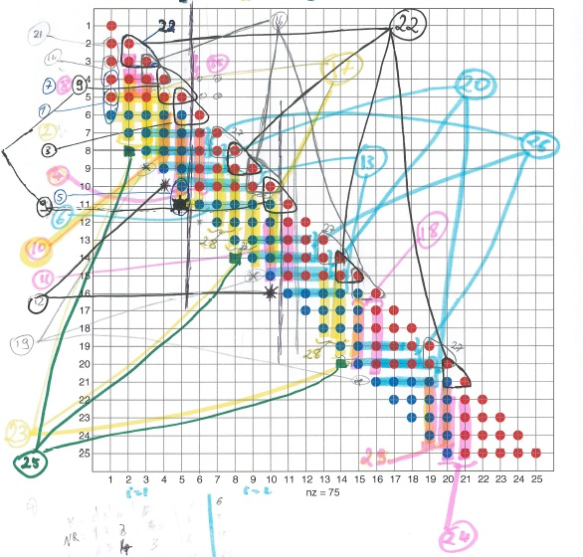
MAGMA Batched Computations

Slide 4
MAGMA Batched Computations
Batched computation
int main (int argc, char *argv[])
{
int nthreads, tid;
/* Fork a team of threads giving them their own copies of variables */
#pragma omp parallel private(nthreads, tid)
{
/* Obtain thread number */
tid = omp_get_thread_num();
printf( »Batched computation from thread = %d\n", tid);
/* Only master thread does this */
if (tid == 0)
{
nthreads = omp_get_num_threads();
printf("Number of threads = %d\n", nthreads);
}
} /* All threads join master thread and disband */
}

Slide 5
MAGMA Batched Computations
  We present here a feasibility design study, the idea is to target the new
  high-end technologies.
  Our goals:
    Develop a high-performance numerical library for batched linear algebra subroutines tuned for performance and energy efficiency on modern processor architectures, CPU, GPU, Phi
    Define modular interfaces that allow code replacement techniques
    [to provide the developers of applications, compilers, and runtime systems with the option of expressing new, application-specific batched computations ]
    Propose template design and code auto generation for performance portability

Slide 6
MAGMA Batched Computations
  We present here a feasibility design study, the idea is to target the new
  high-end technologies.
  Key observations and current situation:
    There is a lack of HPC linear algebra software for small problems especially for GPU
    CPU: this can be done easily using existing software infrastructure
      naïve way: what we call Non-batched design
      better way: Batched design

Slide 7
MAGMA Batched Computations CPU
Non-batched computation
  loop over the matrices one by one and compute either:
  sequentially wasting all the other cores, and attaining very poor performance
  Or using multithread (note that for small matrices there is not enough work for all cores so expect low efficiency as well as threads contention can affect the performance)

Slide 8
MAGMA Batched Computations CPU
Batched computation
  loop over the matrices and assign a matrix to each core working on it sequentially and independently
  Since matrices are very small, all the n_cores matrices will fit into L2 cache thus we do not increase L2 cache misses while performing in parallel n_cores computations reaching the best of each core

Slide 9
MAGMA Batched Computations
  We present here a feasibility design study, the idea is to target the new
  high-end technologies.
  Key observations and current situation:
    There is a lack of HPC linear algebra software for small problems especially for GPU
    CPU: this can be done easily using existing software infrastructure
    MIC: similarly to CPU but, however, today it requires optimizing BLAS routines

Slide 10
MAGMA Batched Computations MIC
Programming model: auto-generation and auto-tuning:
    Many parameter need to be considered, such as:
      Number of registers, cache size, vectorization AVX2, prefectching, intrinsic versus simple loop, etc…
      Data Access Optimizations and Loop Transformation Techniques
      Register Data Reuse and Locality
      Effect of the Multi-threading
      Effect of the NUMA-socket and Memory Location
  Simply
  Need performance analysis (theoretical and tools)
  Many code designs, and each may need tuning

Slide 11
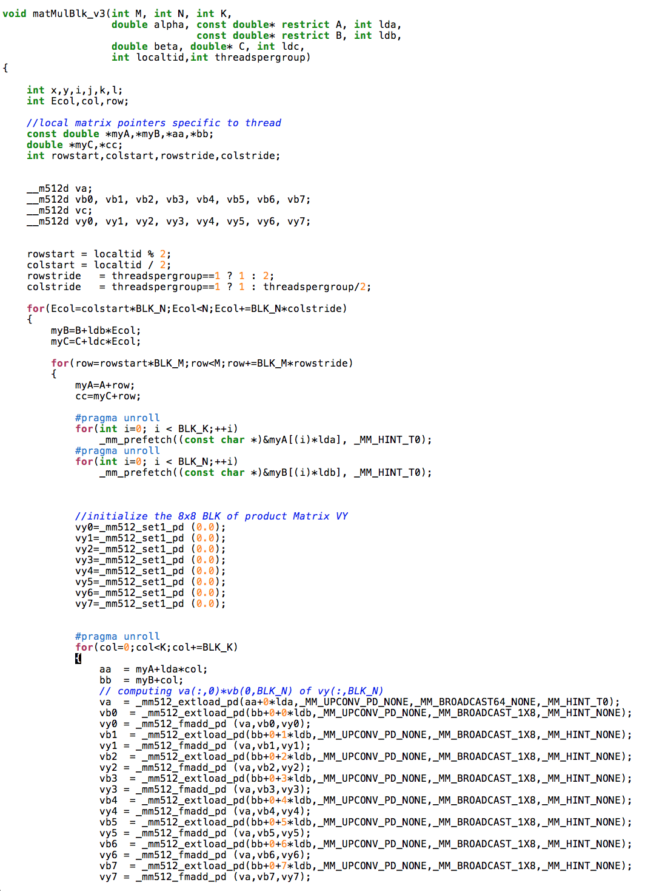
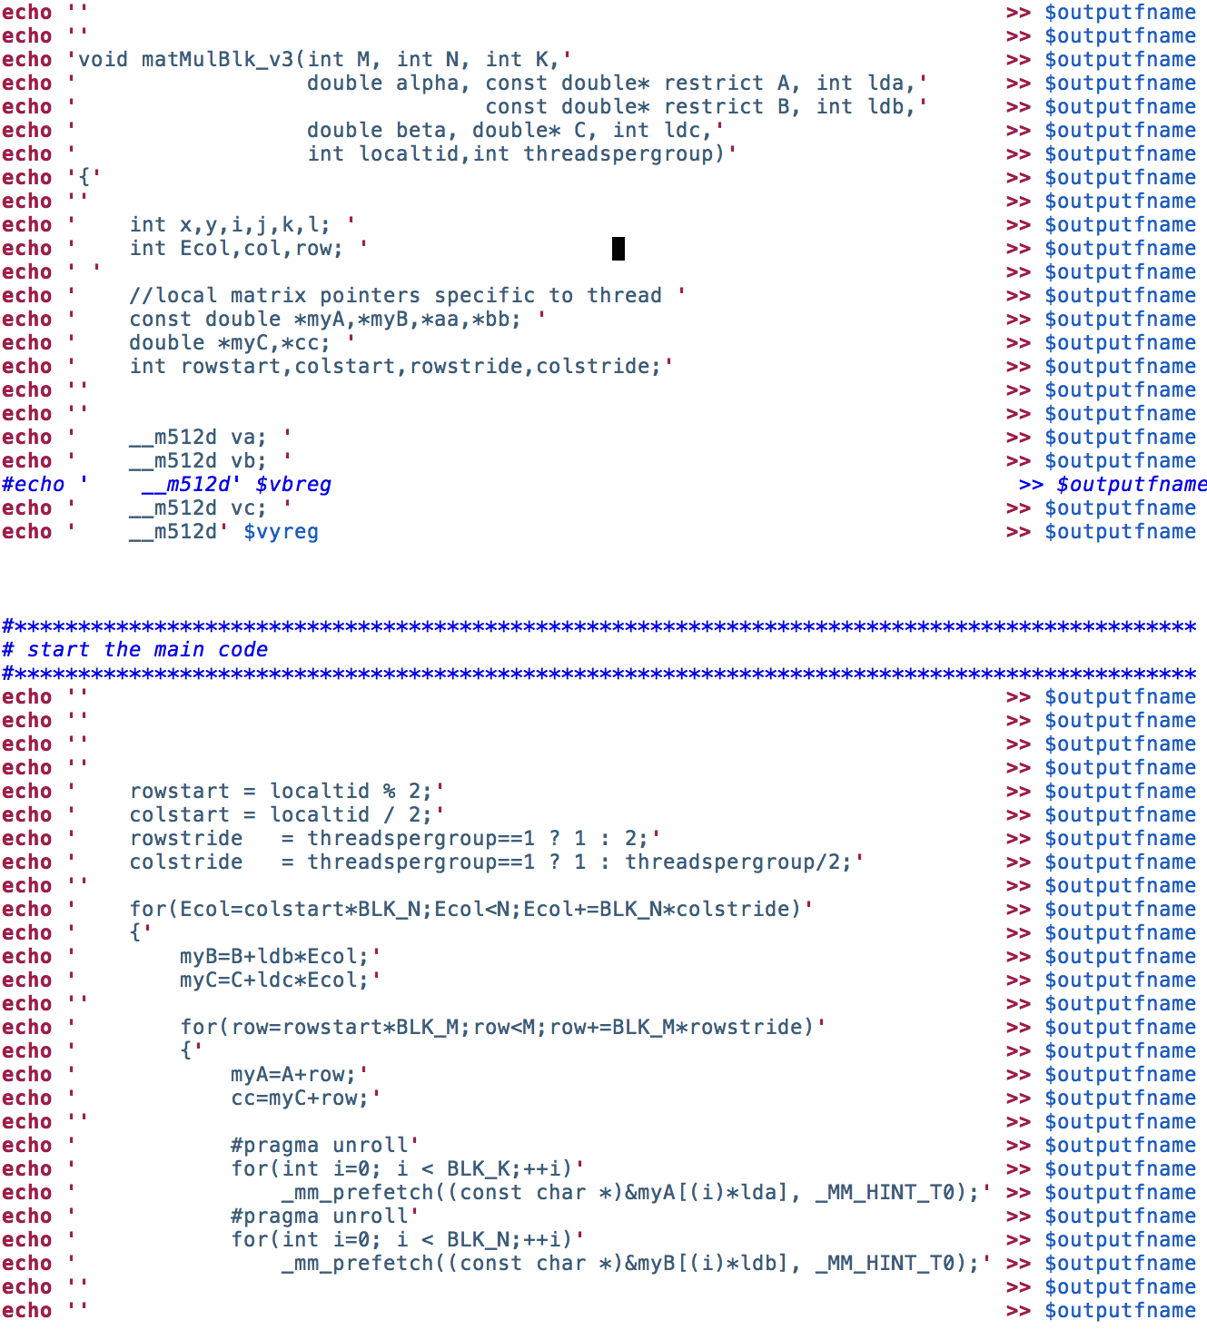
MAGMA Batched Computations MIC
Programming model: auto-generation and auto-tuning:

Slide 12
MAGMA Batched Computations MIC
Programming model: auto-generation and auto-tuning:

Slide 13
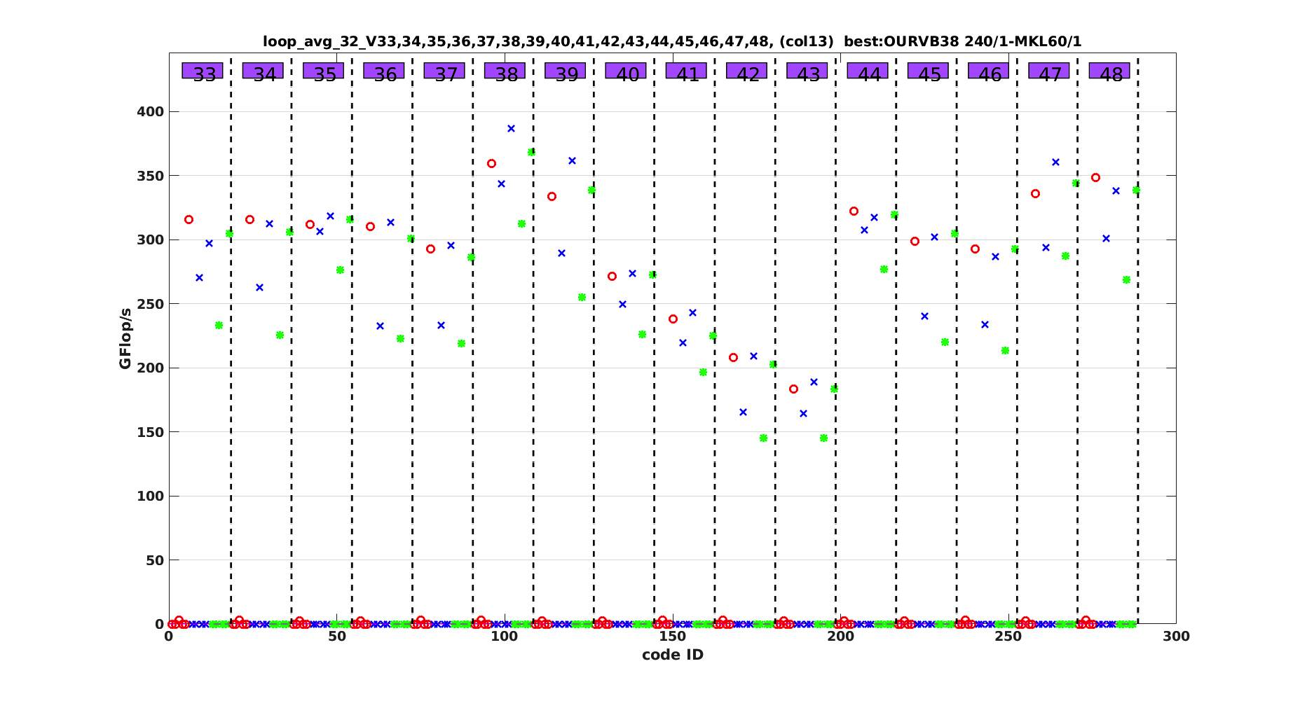
MAGMA Batched Computations MIC
Programming model: auto-generation and auto-tuning:

Slide 14
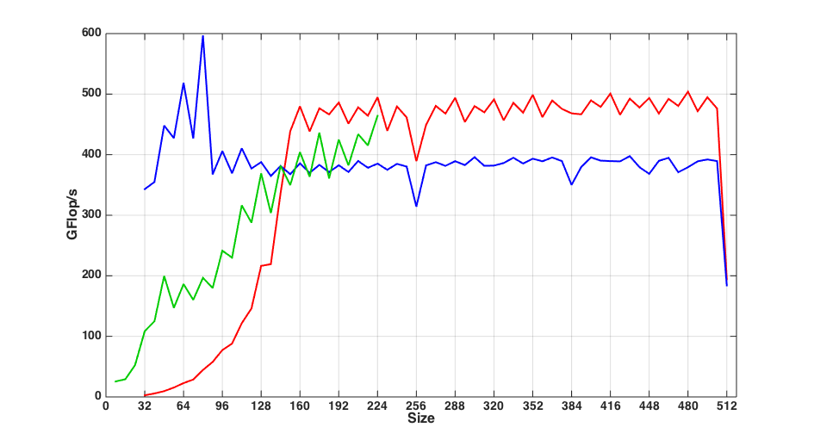
MAGMA Batched Computations MIC
Programming model: auto-generation and auto-tuning:

Slide 15
MAGMA Batched Computations
  We present here a feasibility design study, the idea is to target the new
  high-end technologies.
  Key observations and current situation:
    There is a lack of HPC linear algebra software for small problems especially for GPU
    CPU: this can be done easily using existing software infrastructure
    MIC: Similarly to CPU but, today it requires optimizing BLAS routines
    GPU: are efficient for large data parallel computations, and therefore have often been used in combination with CPUs, where the CPU handles the memory bound and difficult tasks to be parallelized while the GPU is used for data intensive tasks
    What programming model is best for small problems?

Slide 16
Algorithmic basics
Factored part of A
Linear solver Ax=b follow the LAPACK-style
algorithmic design
Two distinctive phases
  panel factorization: latency-bound workload
  trailing matrix update: compute-bound operation
P
a
n
e
l
P_{i}
Trailing
matrix
update
References:
A. Haidar, S. Tomov, P. Luszczek, and J. Dongarra.
MAGMA Embedded: Towards a Dense Linear Algebra Library for Energy Efficient Extreme Computing
IEEE High Performance Extreme Computing Conference IEEE-HPEC 2015, Waltham, MA USA.
Best paper award
A. Haidar, T. Dong, S. Tomov, P. Luszczek, and J. Dongarra.
A Framework for Batched and GPU-resident Factorization Algorithms Applied to Block Householder Transformations
International Supercomputing Conference IEEE-ISC 2015, Frankfurt, Germany.
K. Kabir, A. Haidar, S. Tomov, and J. Dongarra
On the Design, Development and Analysis of Optimized Matrix-Vector Multiplication Routines for coprocessors.
International SuperComputing Conference IEEE-ISC 2015, Frankfurt, Germany
A. Haidar, T. Dong, P. Luszczek, S. Tomov and J. Dongarra.
Batched Matrix Computations on Hardware Accelerators Based on GPUs.
International Journal of High Performance Computing Applications 2014.

Slide 17
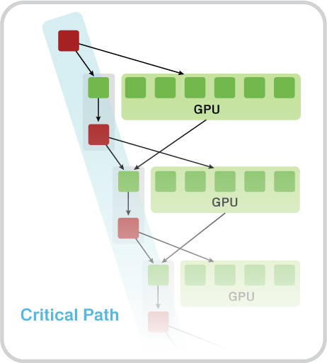
MAGMA Batched Computations GPU
Hybrid CPU+GPU algorithms
(small tasks for multicores and
large tasks for GPUs)
  Classical strategies design
    For large problems the strategy is to prioritize the
    data-intensive operations to be executed by the
    accelerator and keep the memory-bound ones for
    the CPUs since the hierarchical caches are more
    appropriate to handle it
  Challenges
    Cannot be used here since matrices are very small
    and communication becomes expensive
  Proposition
    Develop a GPU-only implementation

Slide 18
MAGMA Batched Computations GPU
  Classical strategies design
    For large problems performance is driven by the update operations, e.g., Level 3 BLAS (GEMM)
  Challenges
    For batched small matrices it is more complicated and requires both phases to be efficient
  Proposition
    Rethink and Redesign both phases in a tuned efficient way

Slide 19
MAGMA Batched Computations GPU
  Classical strategies design
    A recommended way of writing efficient GPU kernels is to use the whole GPU’s shared memory,registers/TB – load it with data and reuse that data in computations as much as possible.
  Challenges
    Our study and experience shows that this procedure provides very good performance for classical GPU kernels but is not that appealing for batched algorithm for different reasons.

Slide 20
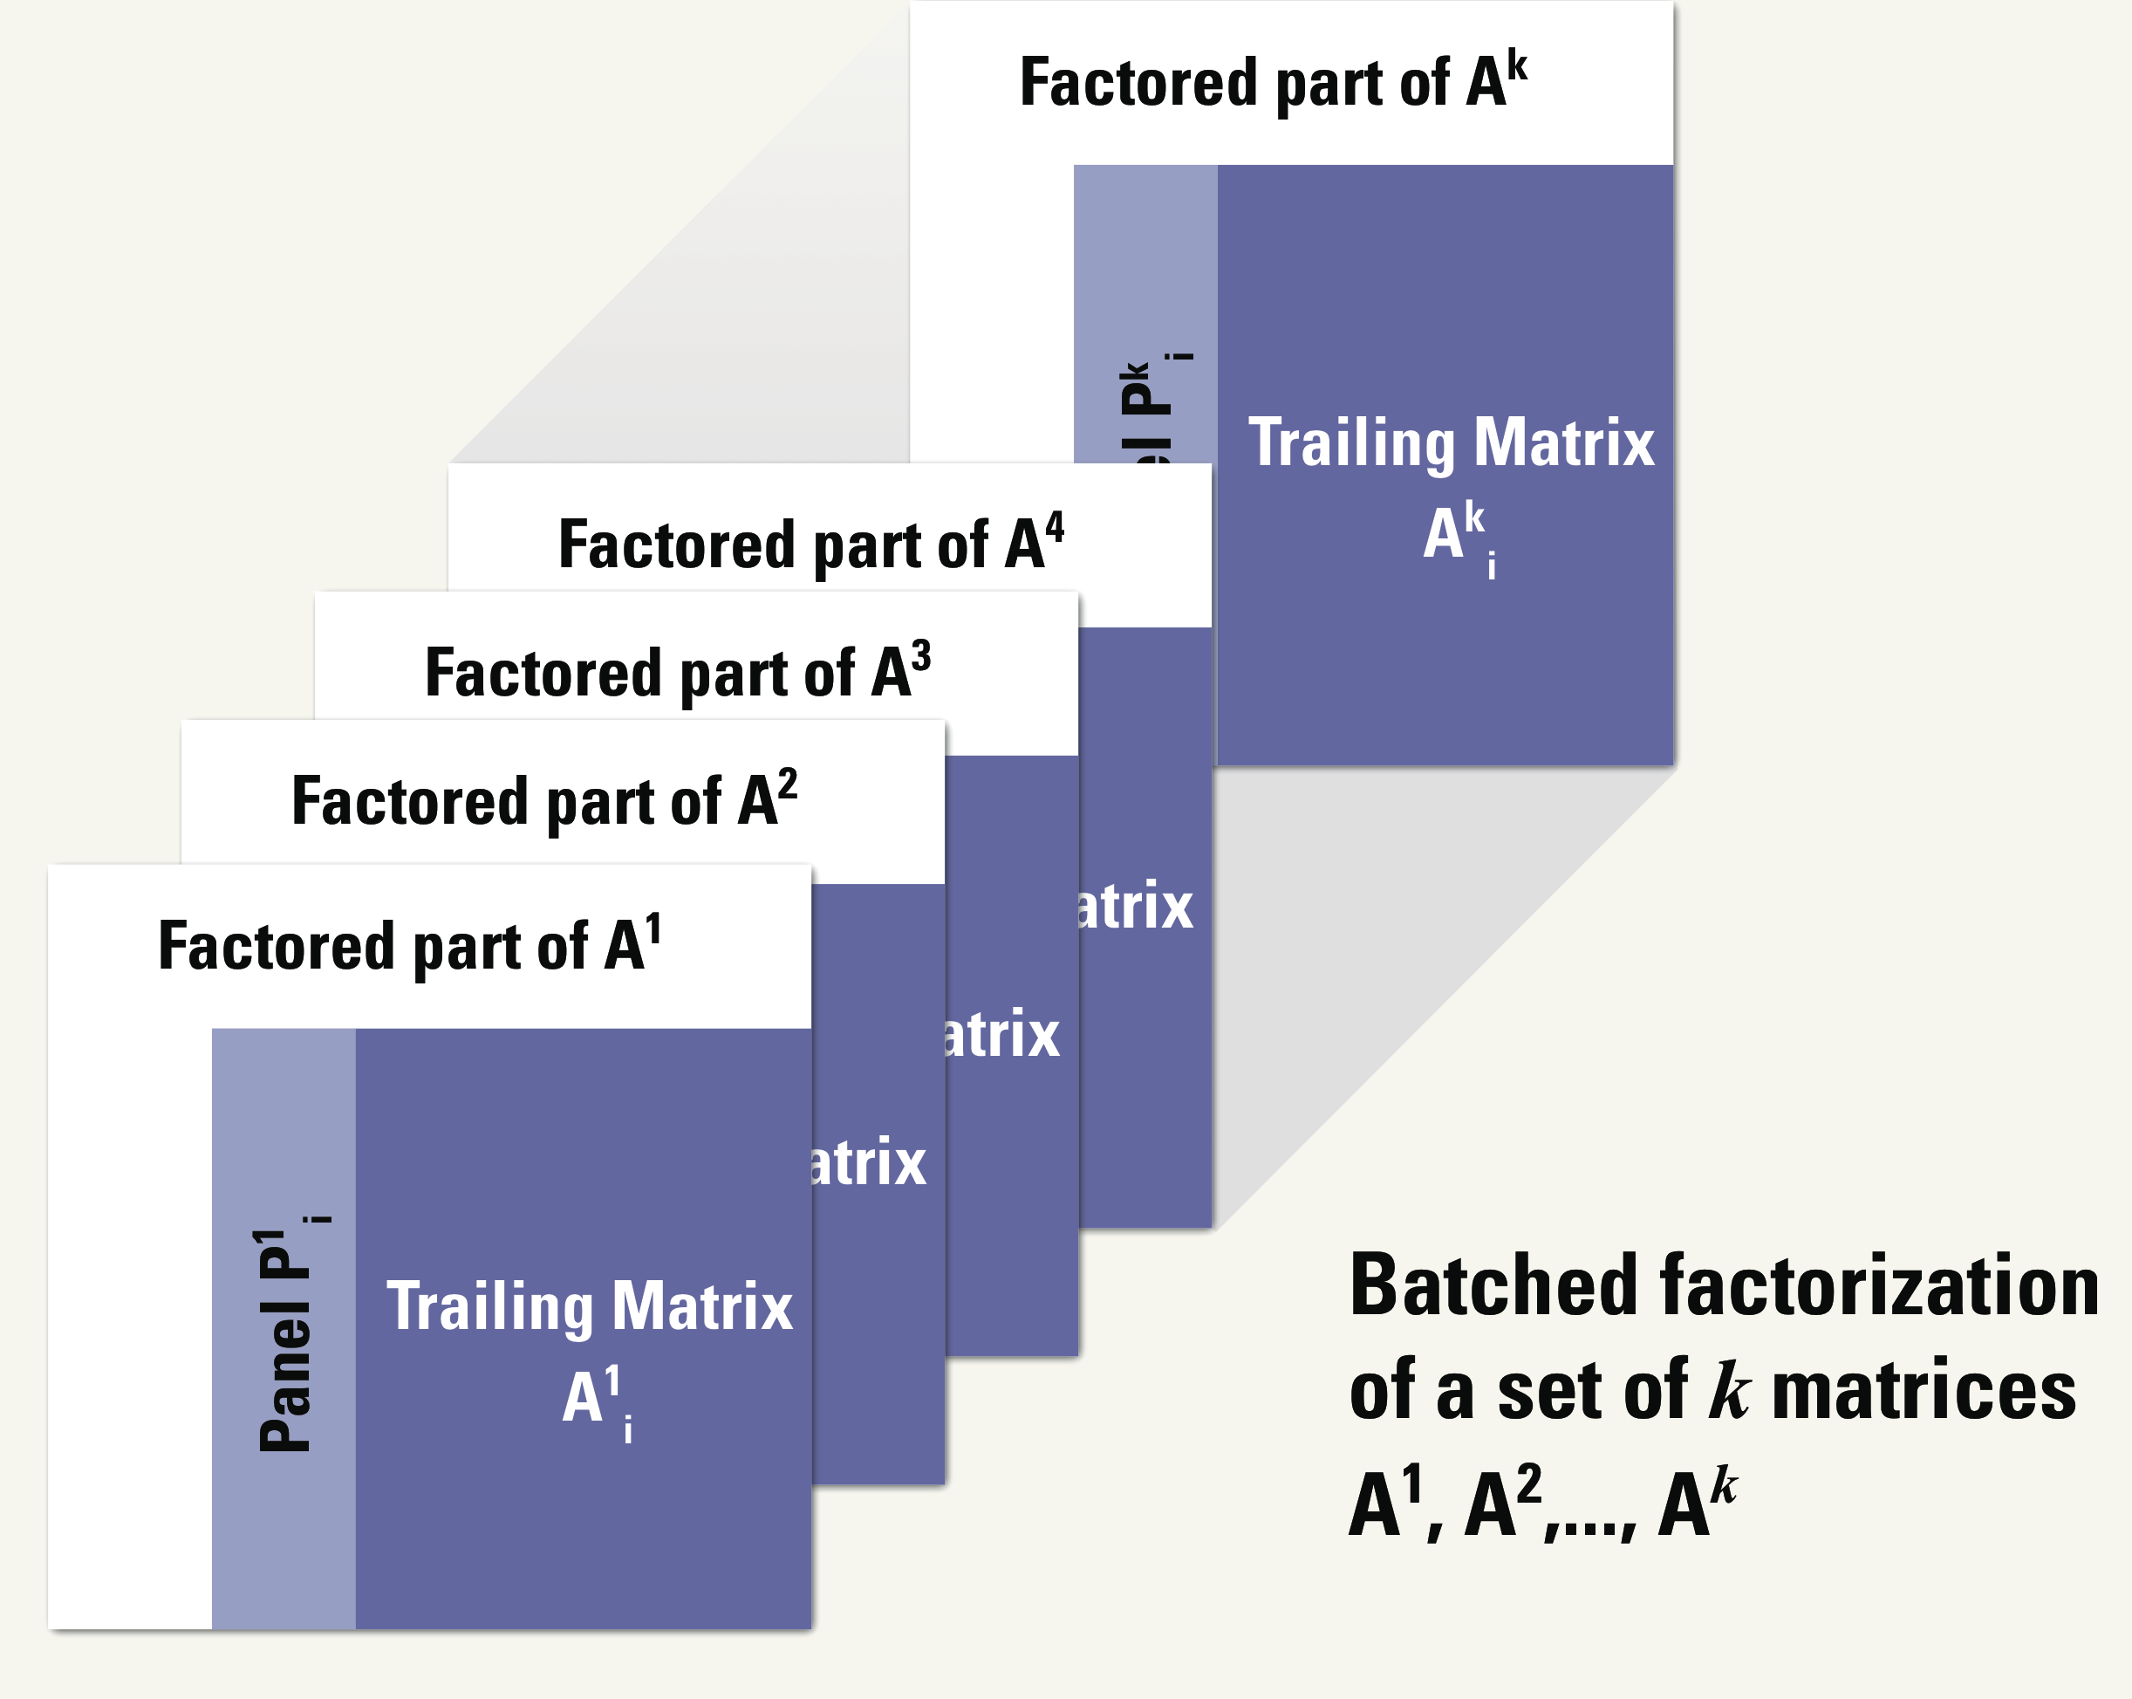
MAGMA Batched Computations GPU
  Challenges
      Completely saturating the shared memory per SMX can decrease the performance of memory bound operations, since only one thread-block will be mapped to that SMX at a time (low occupancy)
      Due to the limited parallelism in the small matrices, the number of threads used in the thread block will be limited, resulting in low occupancy, and subsequently poor core utilization
      Shared memory is small (48KB/SMX) to fit the whole panel
      The panel involves Non-GPU friendly operations:
        Vectors column (find the max, scale, norm, reduction)
        Row interchanges (swap)
        Small number of vectors (apply)
  Proposition: custom design per operations type

Slide 21
MAGMA Batched Computations GPU
  Performance metrics analysis
    A recommended way of writing efficient GPU kernels is to use the whole GPU’s shared memory, registers/TB – load it with data and reuse that data in computations as much as possible.
optimized kernel
using shared memory
left v.s. right looking
autotuned

Slide 22
MAGMA Batched Computations GPU
  Performance metrics analysis
    A recommended way of writing efficient GPU kernels is to use the whole GPU’s shared memory, registers/TB – load it with data and reuse that data in computations as much as possible.

Slide 23
MAGMA Batched Computations GPU
  Performance metrics analysis
    A recommended way of writing efficient GPU kernels is to use the whole GPU’s shared memory, registers/TB – load it with data and reuse that data in computations as much as possible.
We should focus on the performance analysis and the design of a kernel
optimized kernel
using shared memory
left v.s. right looking
autotuned

Slide 24
MAGMA Batched Computations GPU
  Performance metrics analysis
    A recommended way of writing efficient GPU kernels is to use the whole GPU’s shared memory, registers/TB – load it with data and reuse that data in computations as much as possible.

Slide 25
GPU Optimization Summary
MAGMA Batched Computations GPU
Hardware concepts
  CUDA core
  Warp
  Half-warp
  Register file
  Shared memory
  Atomics
  Shuffles
  SMX
Software concepts
  Stream
  Thread block
  Kernel
  Inlining
  Intrinsics
Algorithmic concepts
  Blocking
  Recursive blocking
  Kernel replacement
  Out-of-place operations

Slide 26
MAGMA Batched Computations GPU
Anatomy of Optimizing an Algorithm:
Performance Analysis and Kernels Design of the LU Factorization

Slide 27
MAGMA Batched Computations GPU
Consider the LU factorization
2x8-core Intel Xeon E5-2670 Sandy Bridge socket
NVIDIA Kepler K40 GPU

Slide 28
Profile and trace to find bottlenecks
swap kernel 60%
gemm kernel 15%

Slide 29
Profile and trace to find bottlenecks
classical swap:
swap kernel 60%
gemm kernel 15%
How does the swap work?

Slide 30
Profile and trace to find bottlenecks
Classic swap:
swap kernel 60%
gemm kernel 15%
Parallel swap:
gemm kernel 30%
swap kernel 10%

Slide 31
MAGMA Batched Computations GPU
2x8-core Intel Xeon E5-2670 Sandy Bridge socket
NVIDIA Kepler K40 GPU

Slide 32
MAGMA Batched Computations GPU
Panel factorization
classic dgetf2:
panel: classical getf2 38%
Bottlenecks:
nb large: panel get slower
      --> very bad performance.
nb small: panel get faster but the update is not anymore efficient since dealing with gemm’s of small sizes --> very bad performance.
trade-off ? No effect, since we are talking about small size.
Proposition:
We propose to develop two layers blocking: a recursive and nested blocking technique that block also the panel.
Factored part of A
P
a
n
e
L
Trailing
matrix
update
32

Slide 33
MAGMA Batched Computations GPU
Two-layers blocking:

Slide 34
MAGMA Batched Computations GPU
panel factorization
classical dgetf2:
panel: classical getf2 38%
Recursive blocking of dgetf2:
panel: classical blocked getf2 8%

Slide 35
MAGMA Batched Computations GPU
2x8-core Intel Xeon E5-2670 Sandy Bridge socket
NVIDIA Kepler K40 GPU

Slide 36
MAGMA Batched Computations GPU
batched dgemm 70%
Try to tune and optimize batched dgemm

Slide 37
MAGMA Batched Computations GPU
2x8-core Intel Xeon E5-2670 Sandy Bridge socket
NVIDIA Kepler K40 GPU

Slide 38
MAGMA Batched Computations
Comparison to CPUs
Higher is better
2x8-core Intel Xeon E5-2670 Sandy Bridge socket
NVIDIA Kepler K40 GPU

Slide 39
MAGMA Batched Computations
Comparison to CPUs
Higher is better
2x8-core Intel Xeon E5-2670 Sandy Bridge socket
NVIDIA Kepler K40 GPU

Slide 40
MAGMA Batched Computations
Comparison to CPUs
Higher is better
2x8-core Intel Xeon E5-2670 Sandy Bridge socket
NVIDIA Kepler K40 GPU

Slide 41
Energy efficiency GPU
dgeqrf of 1000 batched matrices of size 1024x1024
2x8-core Intel Xeon E5-2670 Sandy Bridge socket
NVIDIA Kepler K40 GPU
CPU does not include DRAM power

Slide 42
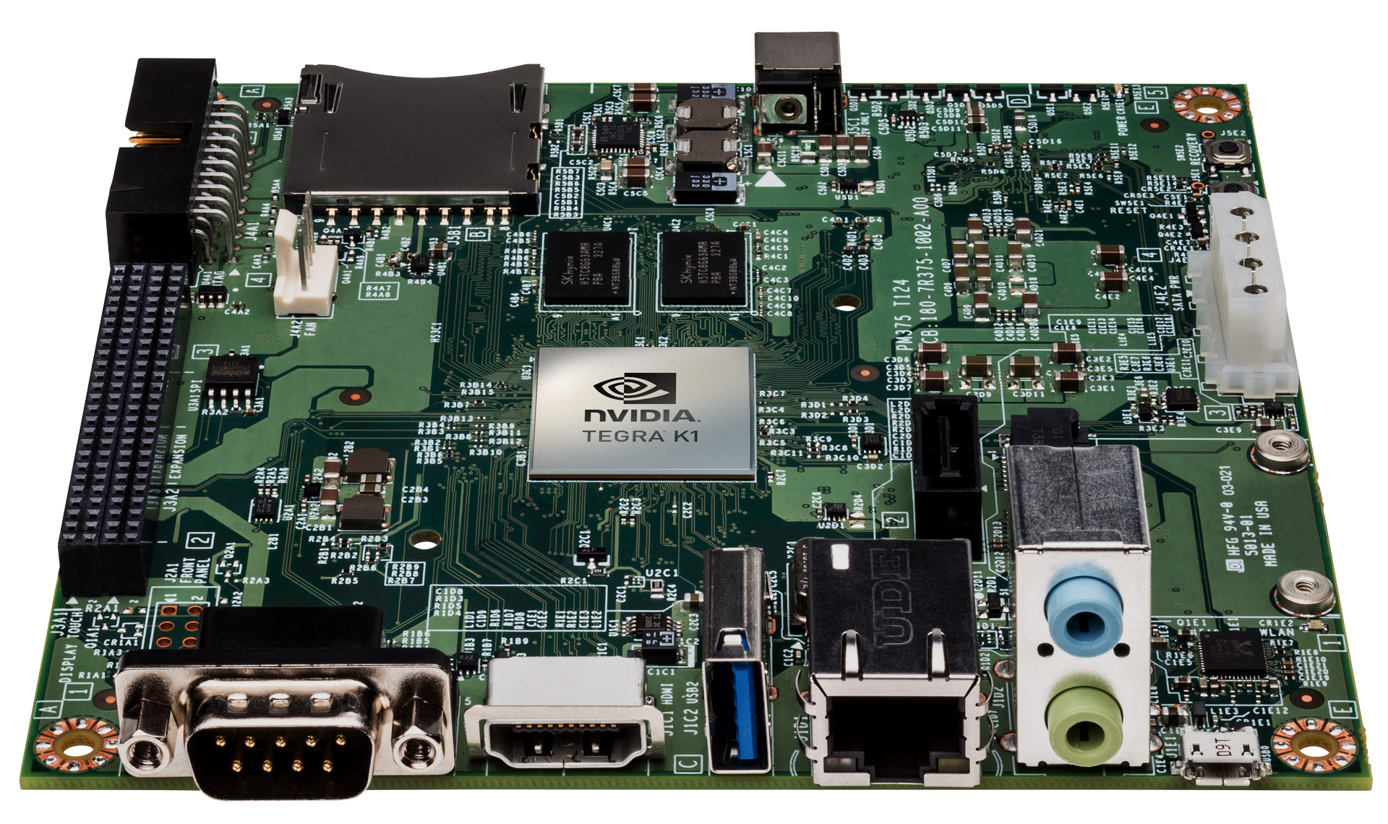
NVIDIA Jetson TK1

Slide 43
Tegra K1 Main Specs
GPU
Architecture | Kepler
CUDA Cores | 192
CPU
Architecture | ARM Cortex A15 r3
Cores | 4-plus-1
Frequency | 2.3 GHz
Memory
Type | DDR3L and LPDDR3
Size | 8 GiB max (40 bit extension)
Display
LCD | 3840x2160
HDMI | 4K (UltraHD, 4096x2160)
Manufacturing Process | 28 nm

Slide 44
QR Factorization Highlights
Perfect tool for imperfect data
Works for over- and under-determined systems
Deals with rank deficient matrices
  Rank-revealing QR (RRQR)
  Better stability than partial pivoting LU on some
Parallelizes well
  Numerical stability allows code optimization
Reduces cost for SVD
  For certain matrix shapes

Slide 45
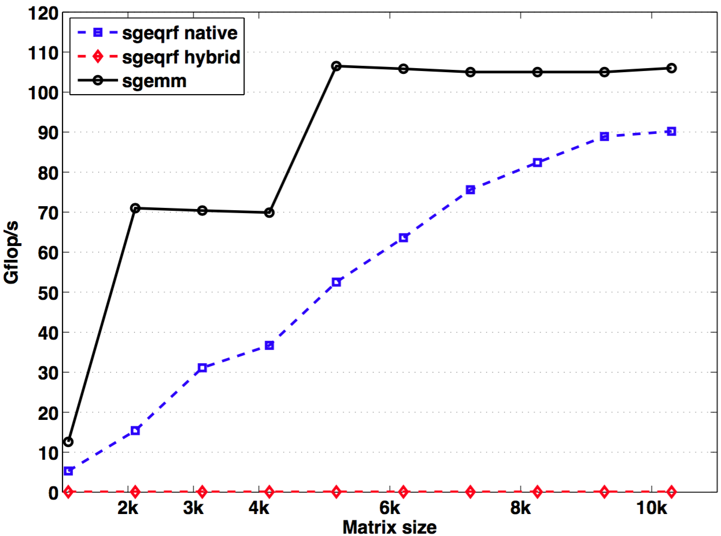
Final Performance
Kepler ~ 100 Gflop/s
ARM ~ 1 Gflop/s

Slide 46
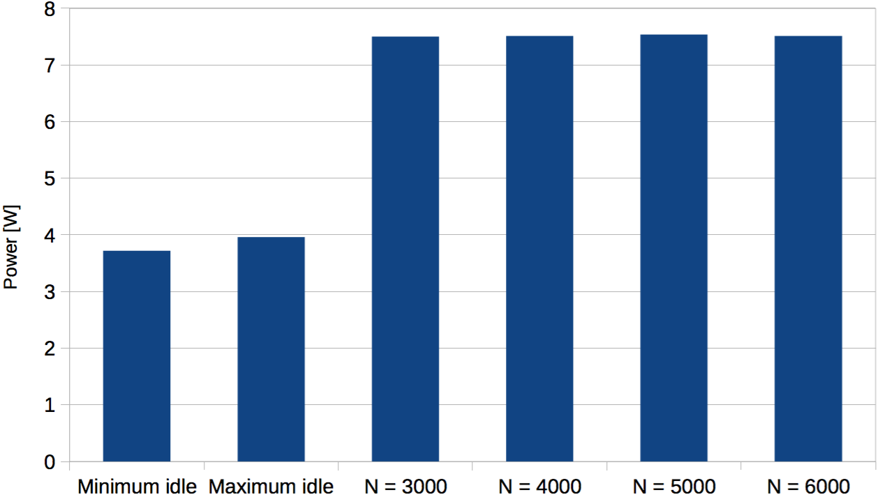
Energy Summary on Jetson

Slide 47
MAGMA Batched Computations
  Summary
  Batched computation can give a boost in performance for problem with very small sizes
  Traditional algorithmic design might not be the best direction
    we need a new way of thinking
    revisit and redesign algorithm to take advantage of the hardware specifics
  Performance modeling can help analyzing algorithm and their implementation, for example
    An optimized GPU function cannot be efficient for all kind of computation, it depend on the context used for
    Small computation are delicate and requires specific kernels (building block or fused).
    Low level API is required to avoid overhead and context switching

Slide 48
Future Directions
Extended functionality
  Variable sizes (work in progress)
  Mixed-precision techniques
  Sparse direct multifrontal solvers & preconditioners
  Applications
Further tuning
  autotuning
GPU-only algorithms and implementations
MAGMA Embedded

Slide 49
References
A. Haidar, S. Tomov, A. Abdelfattah, M. Guidry, J. Billings, and J. Dongarra,
Optimisation Techniques Toward Accelerating Explicit Integration for Large Kinetic Networks.
Submitted to the 45rd International Conference on Parallel Processing, Philadelphia, PA, USA ICPP 2016.
A. Abdelfattah, M. Baboulin, V. Dobrev, J. Dongarra, C. Earl, J. Falcou, A. Haidar, I. Karlin, Tz. Kolev, I. Masliah, S. Tomov,
High-Performance Tensor Contractions for GPUs,
The International Conference on Computational Science ICCS 2016.
A. Abdelfattah, A. Haidar, S. Tomov,
Performance, Design, and Autotuning of Batched GEMM for GPUs,
The International Supercomputing Conference IEEE-ISC 2016, Frankfurt, Germany.
A. Haidar, S. Tomov, P. Luszczek, and J. Dongarra.
MAGMA Embedded: Towards a Dense Linear Algebra Library for Energy Efficient Extreme Computing
IEEE High Performance Extreme Computing Conference IEEE-HPEC 2015, Waltham, MA USA.
Best paper 2015
A. Haidar, T. Dong, S. Tomov, P. Luszczek, and J. Dongarra.
A Framework for Batched and GPU-resident Factorization Algorithms Applied to Block Householder Transformations
International Supercomputing Conference IEEE-ISC 2015, Frankfurt, Germany.
Springer, Lecture Notes in Computer Science Volume 9137, 2015, pp 31-47.
K. Kabir, A. Haidar, S. Tomov, and J. Dongarra
On the Design, Development and Analysis of Optimized Matrix-Vector Multiplication Routines for coprocessors.
International SuperComputing Conference IEEE-ISC 2015, Frankfurt, Germany
Springer, Lecture Notes in Computer Science Volume 9137, 2015, pp 58-73
A. Haidar, T. Dong, P. Luszczek, S. Tomov and J. Dongarra.
Batched Matrix Computations on Hardware Accelerators Based on GPUs.
International Journal of High Performance Computing Applications 2014.
A. Haidar, T. Dong, S. Tomov, P. Luszczek, and J. Dongarra.
Optimization for Performance and Energy for Batched Matrix Computations on GPUs
20th ACM SIGPLAN Symposium on Principles and Practice of Parallel Programming,
Workshop on General Purpose Processing Using GPUs. GPGPU/PPoPP 2015.
T. Dong, A. Haidar, S. Tomov, and J. Dongarra.
A Fast Batched Cholesky Factorization on a GPU
ICPP 2014, The 43rd International Conference on Parallel Processing 2014.

Slide 50








Collaborators and Support
MAGMA team
http://icl.cs.utk.edu/magma
PLASMA team
http://icl.cs.utk.edu/plasma
Collaborating partners
University of Tennessee, Knoxville
Lawrence Livermore National Laboratory,
Livermore, CA
University of California, Berkeley
University of Colorado, Denver
INRIA, France (StarPU team)
KAUST, Saudi Arabia

